Slide 1
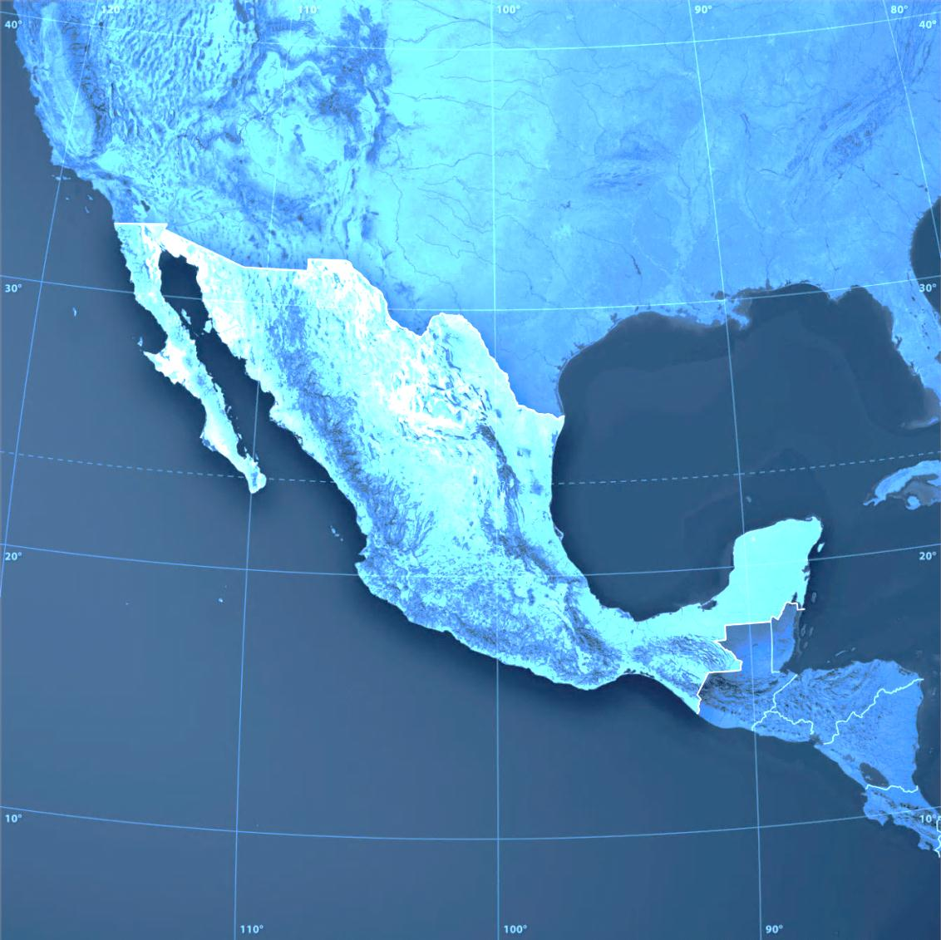
A tale of two Mexicos: Growth and prosperity in a two-speed economy
Jaana Remes
McKinsey Global Institute
May 5, 2014
CONFIDENTIAL AND PROPRIETARY
Any use of this material without specific permission of McKinsey & Company is strictly prohibited

Slide 2
Today’s discussion
What has kept Mexico’s growth disappointingly low in the 20 years under NAFTA?
What are Mexico’s growth prospects now?
How can California benefit from a prosperous Mexico?

Slide 3
Despite NAFTA and reforms, Mexico has not raised its productivity in 30 years
GDP per hour worked
2012 purchasing power parity dollars
19
-0.1%
p.a.
18
17
16
15
+0.8%
p.a.
14
13
+3.3%
p.a.
12
11
10
9
8
7
Desarrollo estabilizador
Excess boom
Lost decade
NAFTA
6
0
1950
60
70
80
90
2000
2012
SOURCE: Conference Board Total Economy Database 2013; McKinsey Global Institute analysis

Slide 4
Behind flat performance is a widening productivity gap between large modern and traditional businesses
1999
2009
Value added per occupied person
$ thousand, constant 2003 $
Compound annual growth rate, 1999–2009 (%)
+5.8
+1.0
-6.5
Number of employees
≤10
11–500
>500
Share of employment
%
1999
2009
SOURCE: Censos Económicos 1999, Censos Económicos 2009, Instituto Nacional de Estadística y Geografía; McKinsey Global Institute analysis

Slide 5
Today’s discussion
What has kept Mexico’s growth disappointingly low in the 20 years under NAFTA?
What are Mexico’s growth prospects now?
How can California benefit from a prosperous Mexico?

Slide 6
3 key levers to boost productivity growth across the economy
Help traditional enterprises evolve into modern, formal SMEs
Expand access to capital, particularly for midsized companies
Continue to make Mexico a place where world-class companies prosper

Slide 7
3 key levers to boost productivity growth across the economy
Help traditional enterprises evolve into modern, formal SMEs
Expand access to capital, particularly for midsized companies
Continue to make Mexico a place where world-class companies prosper

Slide 8
Access to capital is limited relative to other emerging economies, with particularly wide gap in loans
Financial depth, 2013
Stock of debt and equity as % of GDP
447
Government bonds
332
Nonfinancial corporate bonds
Financial institution bonds
14
13
227
201
201
17
9
22
Equity
130
134
8
5
9
116
11
7
13
4
13
Loans
Russia
Mexico
Turkey
India
Brazil
China
S. Africa
Advanced economies
SOURCE: McKinsey Global Institute Financial Assets database; McKinsey Global Institute analysis

Slide 9
3 key levers to boost productivity growth across the economy
Help traditional enterprises evolve into modern, formal SMEs
Expand access to capital, particularly for midsized companies
Continue to make Mexico a place where world-class companies prosper

Slide 10
Today’s discussion
What has kept Mexico’s growth disappointingly low in the 20 years under NAFTA?
What are Mexico’s growth prospects now?
How can California benefit from a prosperous Mexico?

Slide 11
How can California benefit from a prosperous Mexico?
Export market for goods and services geared to Mexico’s growing consuming class
Complementarities in supply chains
New markets and applications for California’s technology and innovation

Slide 12
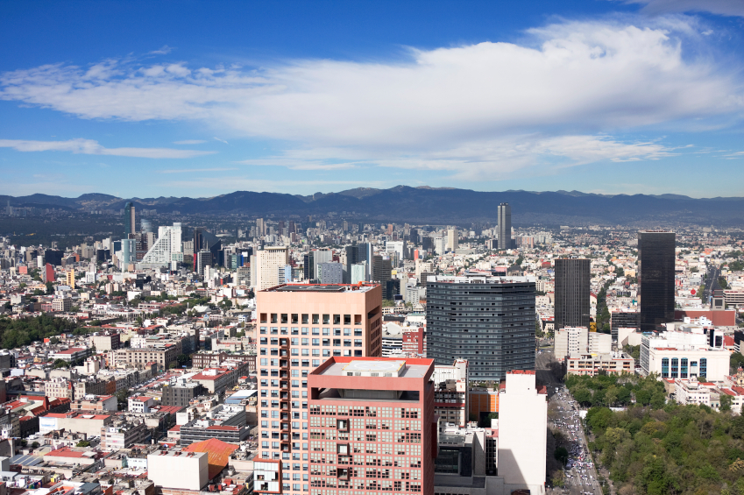
Thank you
This report and other MGI research are available at
www.mckinsey.com/mgi

Slide 13
MGI colors
Theme colors
255
255
255
0
0
0
255
255
255
0
41
96
199
224
251
145
176
255
0
102
204
0
41
96
255
102
0
128
128
128
White
Black
White
McK
Blue
Light
blue
Medium
blue
Bright
blue
McK
Blue
McK
Orange
McK
Gray
Custom colors (MGI)
0
154
166
212
186
0
162
173
0
205
32
44
173
0
91
102
48
124
221
221
221
178
178
178
McK Turquoise
McK Yellow
McK
Green
McK
Red
McK
Pink
McK
Purple
Light
gray
Medium
gray

Slide 14
Placement details
TRACKER
↓ 3.36
STICKER
Unit of measure
↓ 2.77
Legend 1
Unit of measure
if title is 2 lines
Legend 2
Legend 3
Legend 4
Text level 1
Text level 2
Text level 3
Text level 4
Text level 5
← 4.77
4.66 →
↓ 3.22
1 Footnote
SOURCE: Source

