Slide 1
Taking the Distance Out of Caring:
The Role of Telehealth
Thomas Nesbitt, M.D., M.P.H.
Associate Vice Chancellor, Strategic Technologies and Alliances
Director, Center for Health and Technology
Chief Scientist, CITRIS
University of California, Davis

Slide 2
The explosion of new knowledge and information in the health sciences is ironically creating greater disparities in the quality of health care services.

Slide 3
If we discover a treatment or educational intervention for autism, but only half the people have access to it when they need it, we have only discovered half the treatment or intervention
Discoveries and innovation, no matter how good they are, are worthless if not applied appropriately to where and when they needed

Slide 4
Advances in telecommunications and advanced information technologies can help to redistribute health care information and expertise to where and when it is needed

Slide 5
These technologies can help facilitate a new, more efficient model of care across the economic and geographic spectrum.
Notes:
5

Slide 6
History of Telemedicine in the U.S.
NASA STARPAHC late 50s, 1990s for International Space Station
U. Nebraska Psychiatry early 1960s
MGH project with Logan and the VA 1968
Department of Defense/NASA
  Telemedicine and Advanced Technology Research Center (TATRAC)
Telehealth programs exists in every State.
California recognized as a leader in TH

Slide 7
Technology Enabled Health Care System
Care at Home and in the Community
Ambulatory and Clinic Setting

Slide 8
Care at Home and in the Community

Slide 9
e-Mail Communication with Patients by Physicians
Internet use and e-mail communications between patients and providers: a survey of rheumatology outpatients.
Differences by age, gender, education
Siva C, Smarr KL, Hanson KD, Parikh M, Lawlor K, Ge B.
J Clin Rheumatol. 2008 Dec;14(6):318-23.
Patient-physician e-mail: an opportunity to transform pediatric health care delivery.
Over 90% enrolled, 57% faster response
Rosen P, Kwoh CK. Pediatrics. 2007 Oct;120(4):701-6

Slide 10
Traditionally we have used the same process of care for managing chronic conditions as we have used for acute illnesses

Slide 11
Home Telehealth: VA Case Example
February 2006
Today
16,000+ patients enrolled in daily home telehealth with Health Buddy
Deployed in 120+ clinical sites
Over 100 programs for 30+ chronic conditions

Slide 12
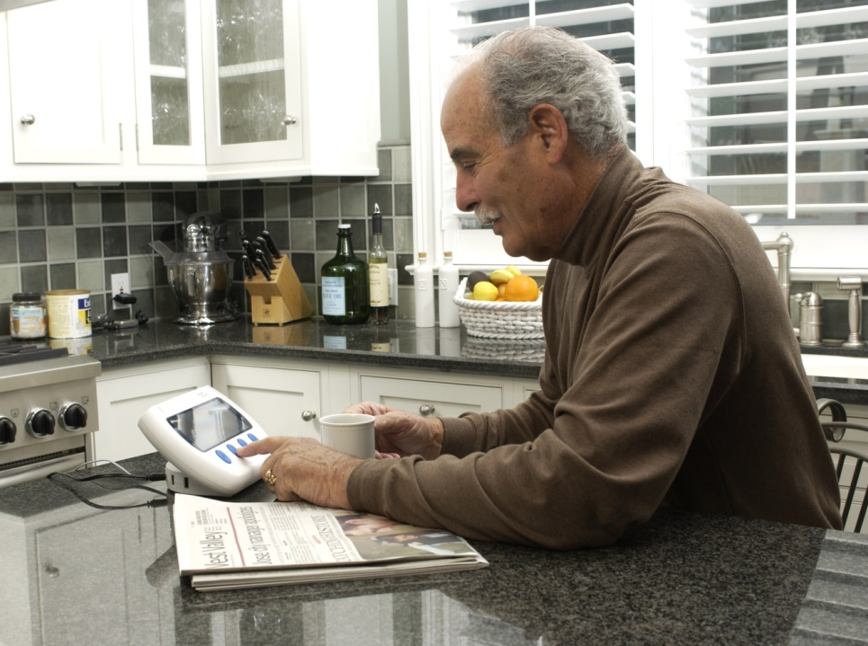
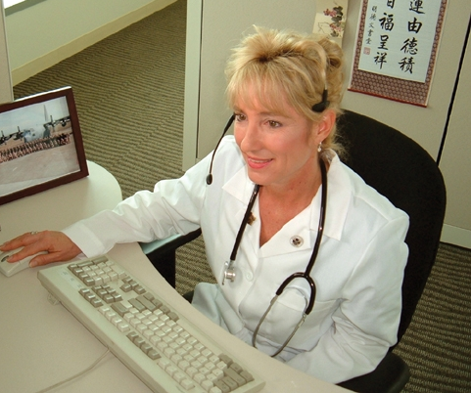
Care Management Process with the Health Buddy System
Scripted messaging,
monitoring and
reporting platform
Education, monitoring and feedback at home
Personalized, remote care management and support.

Slide 13

VA Outcomes 2002:
Telehealth Reduces Inpatient Utilization*
40% reduction in ER visits
63% reduction in hospital admissions
63% reduction in hospital bed days of care
64% reduction in nursing home admissions
88% reduction in nursing home bed days
Significantly improved Quality of Life SF36V
1-Year Telemedicine Care Coordination Demonstration
*Published in Disease Management Volume 5, Number 2, 2002.

Slide 14
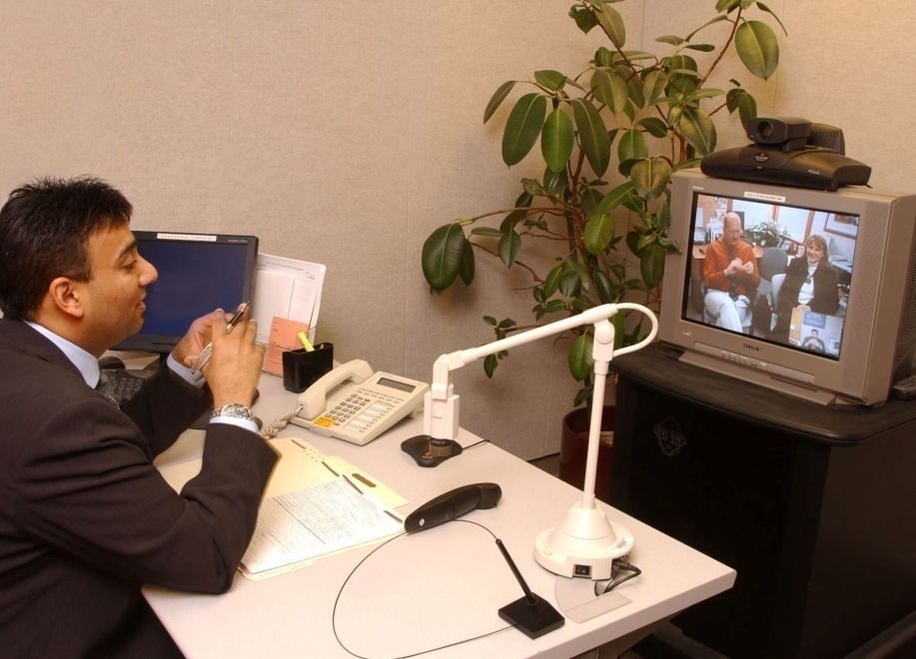
Outpatient Telemedicine
Interactive healthcare over distance using technology
Telemedicine brings the expertise of a specialist to the point of care and allows that expertise to be customized to that patient

Slide 15
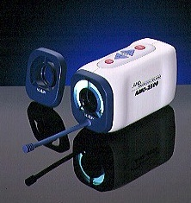
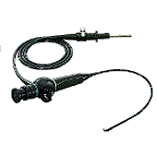
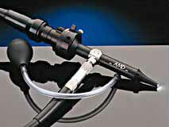
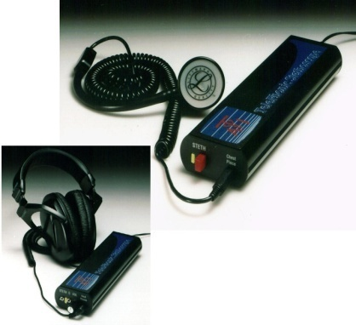
Medical Peripherals
General Exam Camera
Nasopharyngoscope
Otoscope
Electronic stethoscope
Notes:
There are literally hundreds of different medical peripherals on the market today. These are just some of the common ones used in telemedicine today.

Slide 16
Referral Guidelines

Slide 17
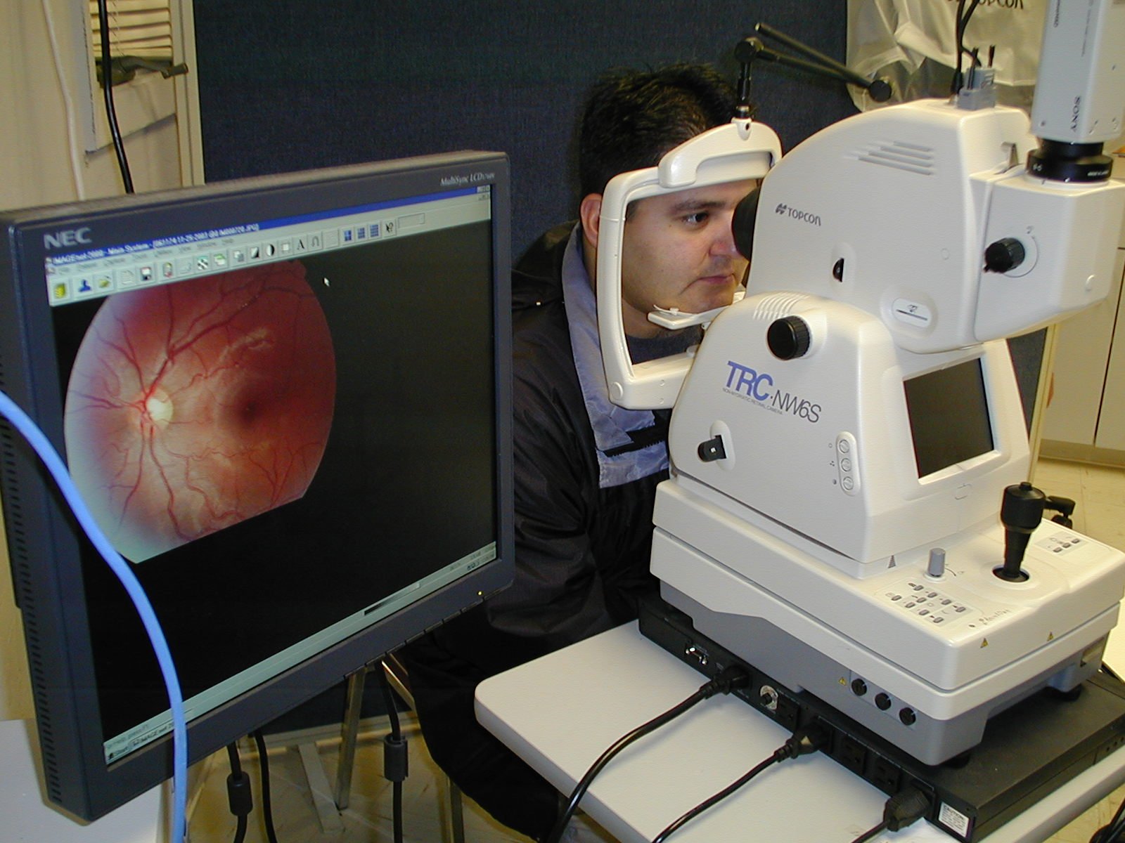
S&F Ophthalmology and Dermatology

Slide 18
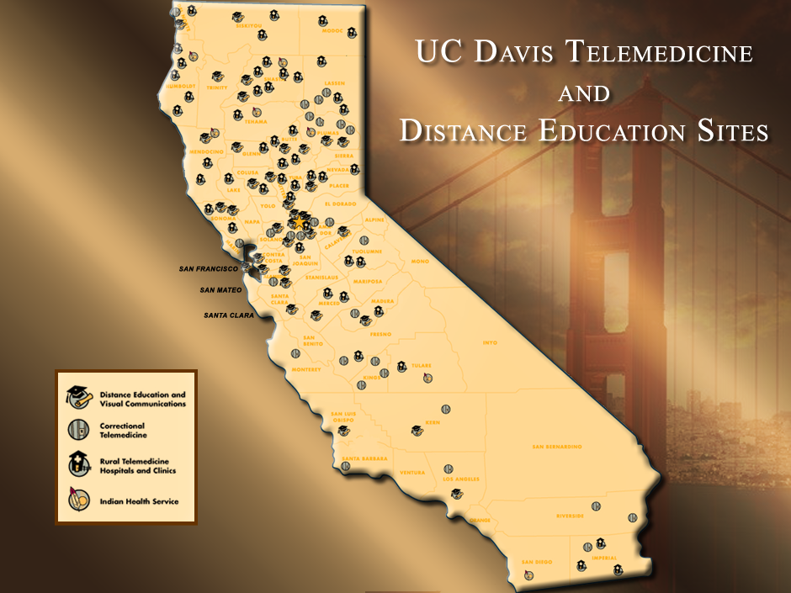

Slide 19
Evidence for telemedicine effectiveness: Satisfaction
Many satisfaction studies done
Teledermatologic consultation and reduction in referrals to dermatologists: a cluster randomized controlled trial. Eminović N, et al.
No sig. difference in satisfaction
Arch Dermatol. 2009 May;145(5):558-64
Child and adolescent telepsychiatry: utilization and satisfaction. Myers KM, Valentine JM, Melzer SM
High parental satisfaction with tele-psych
Telemed J E Health. 2008 Mar;14(2):131- 136

Slide 20
Select Focus Areas In Outcome Studies
  Dermatology
    Diagnosis agreement high comparing (differential) diagnosis via telemedicine and clinic-based examiners (Whited, 1999, 2001; Wootton, 2000)
    Teledermatology consults resulted in 76% treatment changes, 52% diagnostic changes from those of the referring general practitioner (Lamminen, 2000)
    Clinical outcomes in skin cancer management via S&F TM as measured by times to diagnosis and to surgical treatment can be comparable, if not better than, conventional management ( Hsiao J. et al. J Am Acad Dermatol 2008)

Slide 21
Select Focus Areas In Outcome Studies
Clinical Consultations
  Psychiatry
    Diagnosis and management plan agreement high between in person and telemedicine (Elford, 2000; Ruskin, 1998)
    Psychiatric consultation and short-term follow-up can be as effective when delivered by telepsychiatry as when provided face to face. O'Reilly R, Bishop J, Maddox K, Hutchinson L, Fisman M, Takhar J. Psychiatr Serv. 2007 Jun;58(6):836-43
    Changes in diagnosis, treatment, and clinical improvement among patients receiving telemedicine consultations Marcin JP, Nesbitt TS, Cole SL, Knuttel RM, Hilty DM, Prescott PT, Daschbach MM.
  Telemed J E Health. 2005 Feb;11(1):36-43.

Slide 22
Telehealth in ASD:
Using telemedicine to conduct behavioral assessments. Barretto A, Wacker DP, Harding J, Lee J, Berg WK. Journal of Applied Behavior Analysis. 2006 Fall;39(3):333-40.
Telepractice in the assessment and treatment of individuals with autism spectrum disorders: A systematic review. Boisvert M, Lang R, Andrianopoulos M, Boscardin ML. Developmental Neurorehabilitation. 2010;13(6):423-32.

Slide 23
Essential requirements for an optimally functioning technology enabled health care system include widely distributed broadband connectivity which is reliable, with explicit quality of service (QOS), security, privacy

Slide 24
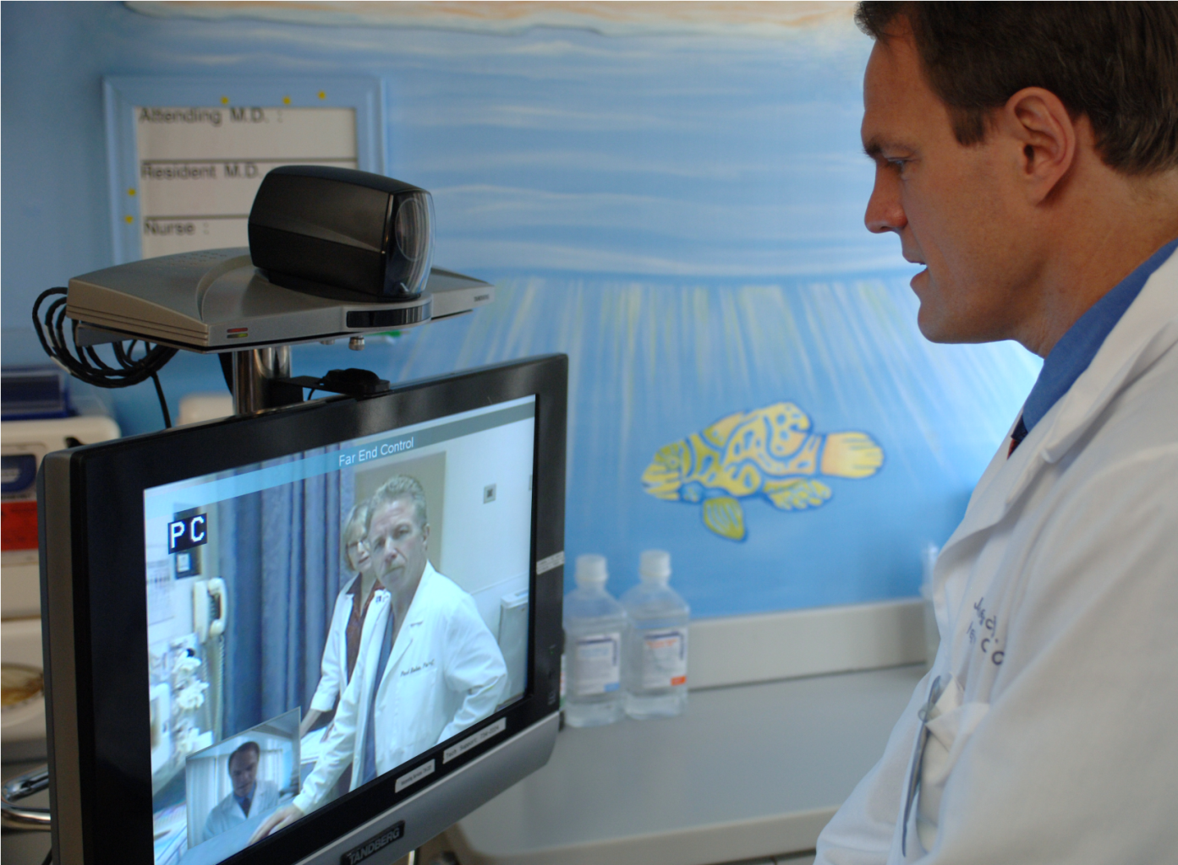
The California Telehealth Network
Building a digital health care highway
Notes:
24

Slide 25
Key Specifications:
What makes CTN unique?
An “Any to Any” network
  Any site can make a direct connection to any other site
System defines and manages prioritized traffic with explicit quality of service standards
  Prioritizes types of traffic by medical need, delivered at a defined quality of service
Create a “security envelope”
  Security utilities, Web content filtering, and No transit of patient information over the public Internet
Favorable rates
  Standardized rates regardless of the health care site’s location eliminates costly distance charges

Slide 26
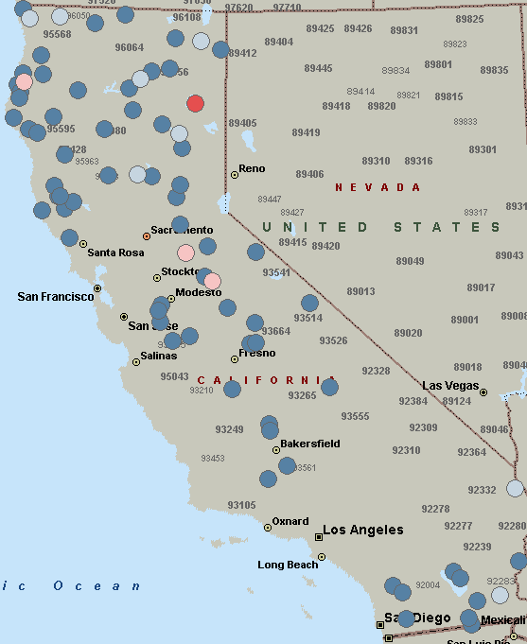
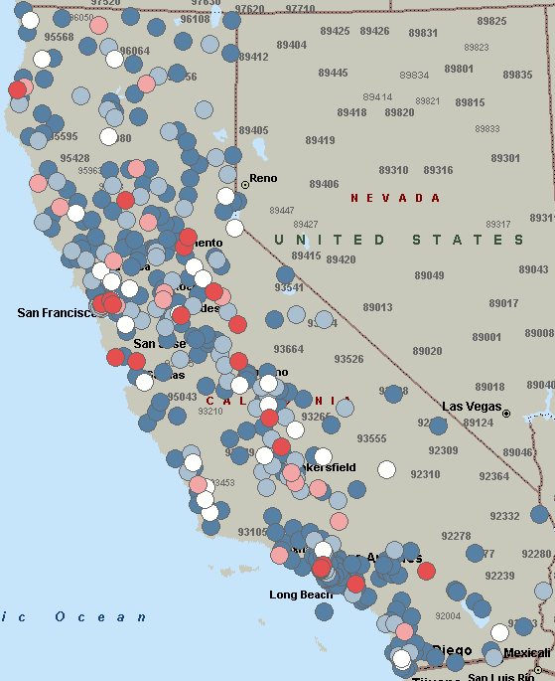

Network Scale: California Telehealth Sites
FY 2007
FY 2012
Frequency by
Zip Code:
4
3
2
1

Slide 27
Training the next generation in telehealth
Proposition 1D: K-University Public Education Facilities Bond Act of 2006
  “…the amount of $200 million shall be used for capital improvements that expand and enhance medical education programs with an emphasis on telemedicine aimed at developing high-tech approaches to health care.”

Slide 28
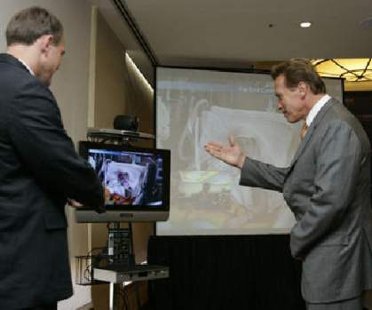
California’s Proposition 1D Passes
“With Proposition 1D we will be able to connect our best hospitals and our best medical schools with clinics in remote areas all over the state of California.”
Governor Arnold Schwarzenegger
10/27/2006 UC Davis Pediatric Telehealth Colloquium
UC Davis Pediatric Telehealth Colloquium
funded in part by William Randolph
Hearst Foundation

Slide 29
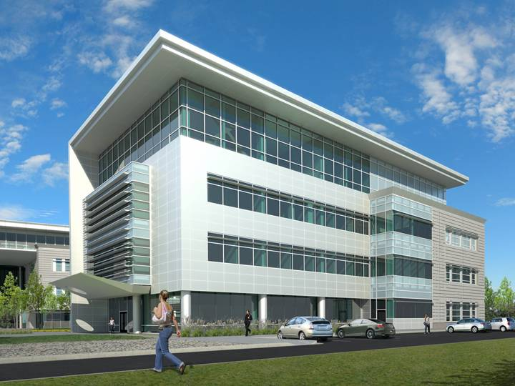
Telemedicine Resource Center & Rural PRIME Facility
Project Scope
Four-story addition to UC Davis School of Medicine Education Building
52,141 gross square feet
Total project cost of $36,000,000 (includes approximately $6M for equipment)

Slide 30
Summary
Advanced information and telecommunications technologies have a central role to play in transforming our health care system
Evidence based models of care, facilitated by technology potentially can improve access and quality across the economic and geographic spectrum
Policy changes can help facilitate this transformation

