Slide 1
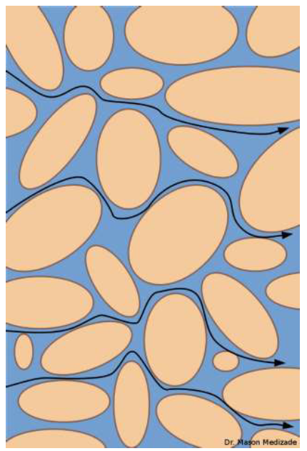
Traditional acid well stimulation*
Oil is found in pore spaces in geologic formations
The goal of acidizing is to improve porosity and permeability so oil flows better to the well
Idealized geologic formation
Sand grain
Pore space
Oil flow path
* Based upon the Powerpoint presentation “Petroleum Well Acidizing Stimulation” by Dr. Mason Medizade (CalPoly SLO), © 2013 by Mason Medizade

Slide 2
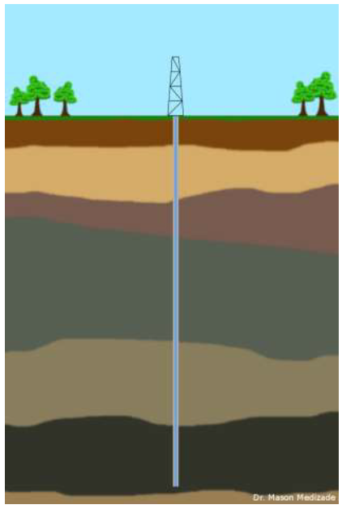
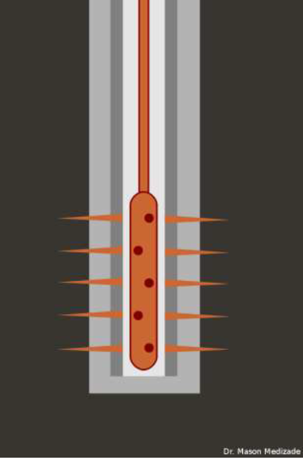
After drilling a well, the producing section is perforated
perforations

Slide 3
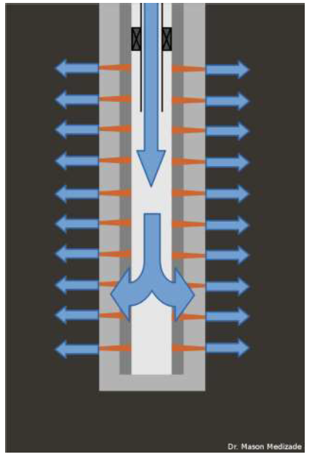
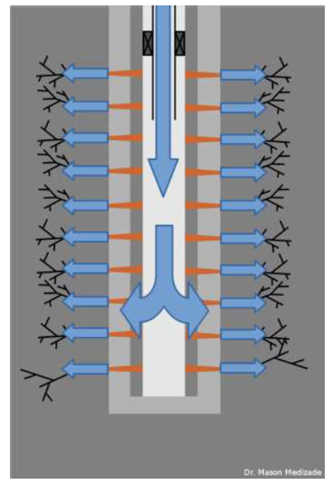
In traditional acid well stimulation, a series of chemical mixtures, including a main acid stage, are injected into the well to clean-up near the wellbore any damage or obstructions to oil reaching the well from the drilling process.
The chemicals added may include strong and weak acids, corrosion inhibitors, de-emulsifiers, etc.
Acid washing is performed on the wellbore to remove scale or open the perforations
Injections into the formation include acid matrix stimulation and acid fracturing
Acid treatments being injected into the formation (above)

Slide 4
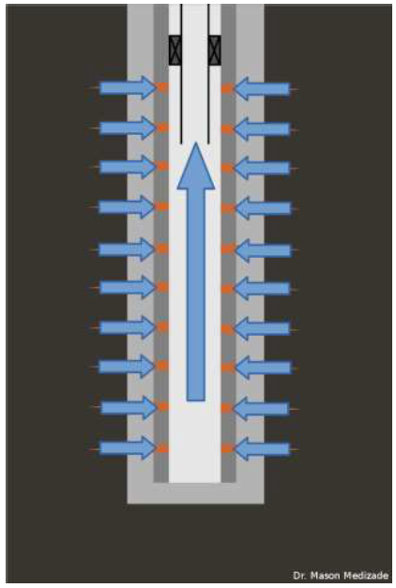
Acid matrix stimulation is at pressures below the fracture pressure of the formation, and acid fracturing is above.
The acid treatments work by dissolving obstructions, including in the formation, and increasing the ability of the oil to flow to the wellbore and be produced.
Oil flowing to the wellbore to be produced

