Slide 1
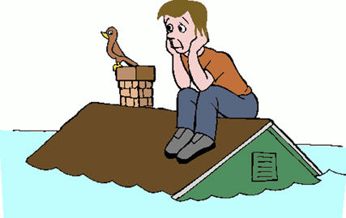
Senate Natural Resources & Water Committee Informational Hearing Chronically Underfunded Water Needs
Melinda Terry, Executive Director
CA Central Valley Flood Control Association

Slide 2
CCVFCA
Established in 1926
Over 70 members with flood control responsibilities
Membership extends from Chico down to Tracy

Slide 3
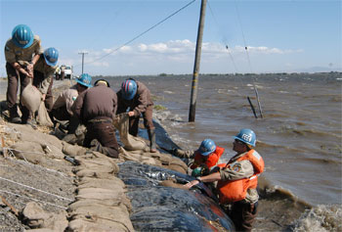
Floods Happen
About every 10 years (2006, 1997, 1986, 1964, 1956, 1951, etc.)
Since 1950 flood disasters have been declared in every California county at least nine times.
Since 1983 the State’s project levees (SPFC) have breached or overtopped more than 50 times.
1986 Flood – City of Sacramento almost evacuated (Folsom Dam spilling more than designed), State sued for levee failure in Linda.
1997 Flood – All Central Valley counties declared disaster areas; levee failures flood Olivehurst, Arboga, Wilton, Manteca, and Modesto; 120,000 people evacuated; over 9,000 homes destroyed; and over $1 billion in direct flood damages
2015 El Nino – Strongest since 1997
Reducing flood risks costs less than paying for flood damage

Slide 4
State Responsibility
Delay Can Cost State Billions
1 million people in Central Valley floodplains
$70 billion in assets at risk
$3 billion cumulative flood damages (1983, 1986, 1995, 1997)
$464 million lawsuit payout (Paterno)
$17 billion of flood risk reduction funding need identified in 2012 CVFPP
$5 billion needed to achieve 200-yr urban protection

Slide 5
Funding Needs
PUBLIC SAFETY
SPFC levee and channel bypass inspection, maintenance and enforcement
CVFPP/200-yr urban flood protection projects
Non-project levee and statewide flood protection
FISCAL RESPONSIBILITY
Eligibility for USACE & FEMA disaster funding (PL 84-99)
State liability for flood damage lawsuits
DISASTER RESPONSE
Emergency response
Levee Repairs

Slide 6
Funding Challenges
Waning Bonds: Nearing end of Prop. 1E/84 flood protection funding, only $395 million in 2014 Prop. 1.
Liability: Responsible for flood protection of 1.7 million acres covered by SPFC system (last payment for Paterno lawsuit damages from 1986 levee failure).
Prop. 218: Can only assess for direct and proportional flood protection benefits (general benefits not allowed) and must compete with other voter-approved special assessments.
Federal Funding: Congressional funding delays (WRRDA), flood insurance increases (FEMA/NFIP), and ineligible for USACE & FEMA disaster funding.

Slide 7
Good News
CVFPP Regional Planning has identified important flood control projects and is evaluating funding options
CVFPB has new encroachment enforcement program
Local agencies conduct levee maintenance at lower cost
Delta Subventions program has been very successful
Delta Protection Commission is conducting feasibility study on opportunities for “beneficiary pays” fees
Approval of State bond funding and local assessments has resulted in significant levee work since 2006

Slide 8
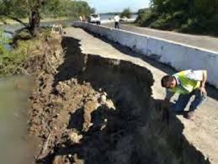
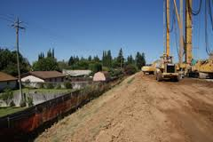
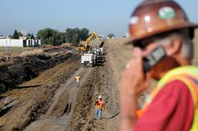
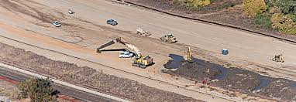
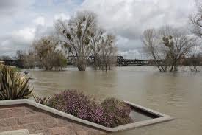
Bond Funding in Action Flood Risks Flood Protection Projects

Slide 9
Bad News
Reduced state bond funding, evaporating federal funding, and local assessment challenges are practical realities.
USACE recovery $$ - rescinded (over 70% SPFC facilities not eligible)
Rural areas will not meet federal cost-benefit ratio
Loss of FEMA recovery $$ - rescinded for Delta
CVFPP – Identified $17 billion in long-term funding needs, but 2006 Prop. 1E/84 coming to end and only $395 in 2014 Prop. 1
El Nino is coming . . . .

Slide 10
Funding Considerations
CAUTION
Failed Regional Assessments - CVFPB
Overlapping Fee Competition – State fire prevention fee (SRA)
Non-Flood Benefits – General benefits such as ecosystem restoration and State interests such as SWP/CVP water supply cannot be assessed by local flood control agencies under Prop. 218

Slide 11
El Nino Effect
Emergency Response
Levee Repairs – State share for federally eligible levees and full repair cost for ineligible SPFC and Delta levees
Floodfighting - Feds will cost-share, but equipment, supplies and personnel availability are critical
Debris Management – Dead trees from recent fires can create logjams for flood flow, damage bridges, and mudslides can close roads and water supply
Post-Flood Costs
Levee Damage – Erosion and seepage fixes
Channel Clearance – Sediment and debris removal
Liability – Potential damage claims for SPFC levee failures

Slide 12
Recommendations
PROACTIVE STRATEGY
Reduce Probability – Consistent annual appropriations for routine levee and channel maintenance reduces risk of levee failures and damage liability lawsuits
Protect SPFC – CVFPB has new enforcement program to prevent new or remove existing illegal encroachments that threaten levee integrity
El Nino Preparedness – Act now to implement urgent, “critical” repair projects to address known weakest links:
Reinforced Levees (e.g., rock waterside, construct landside berms, fix collapsing culverts/pipes within levee)
Efficient Drainage – (e.g., sediment and vegetation removal, new pumps)

