Slide 1
Working Together to Tackle Ocean Acidification & Hypoxia (OAH) in California
Senate Natural Resources and Water Committee
Oversight Hearing
January 26, 2016
Catherine Kuhlman
Executive Director, California Ocean Protection Council
Notes:
Hello
Excited to be here
Quick intro

Slide 2
I am here today because…
OAH spans silos and is about building ocean health and planning for smart action
Therefore, with the wrap up of the panel, we need cooperation that extends beyond California while considering the state’s interests and goals
Through such state and regional efforts, we will advance conversations to manage OAH in a collaborative, effective way, and to elevate oceans in the climate conversation
The West Coast and California can continue to be the leader on ocean action

Slide 3
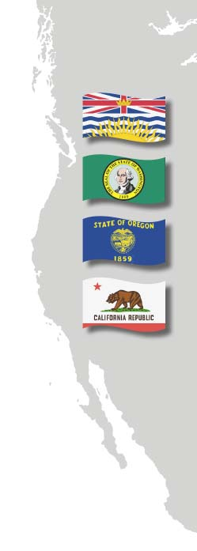
The Pacific Coast Collaborative
Brings together West Coast leaders as a common front on climate and energy challenges facing Pacific North America
Identified ocean acidification as a key challenge for the West Coast in a 2013 letter to the President and the Canadian Prime Minister; asked for targeted action at all levels of government
Has continued to identify acidification and hypoxia as urgent ocean health issues; paving the way for greater regional, cross-border, and national efforts to address these issues
Notes:
Here representing our Governors and Premier.
We’re in a position to lead the nation on preparing for the threats of climate change, of which ocean acidification and hypoxia (OAH) are included.

Slide 4
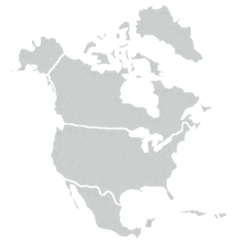
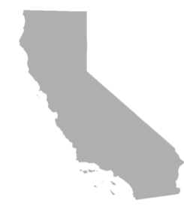
A Shared Challenge: Building on the Statewide Efforts
SINGLE STATE EFFORTS
ALIGNING EFFORTS ACROSS WEST COAST
ENGAGING NORTH AMERICAN PARTNERS
Ocean Protection Council
Ocean Science Trust
WA Blue Ribbon Panel – MRAC
OR Institute for Natural Resources
NOAA
US EPA
CEQ
Fisheries and Oceans Canada
Pacific Coast Collaborative
West Coast OAH Science Panel
OPPORTUNITY TO INFORM:
SINGLE STATE PRIORITIES
LEGISLATURE
OPPORTUNITY TO INFORM:
OPPORTUNITY TO INFORM:
WATER QUALITY
NATURAL RESOURCES
LEGISLATURE
LAND USE/AIR QUALITY
WATER QUALITY
NATURAL RESOURCES
LEGISLATURE
LAND USE/AIR QUALITY
HIGH LEVEL POLICY
Notes:
In response to the WA Panel and the hatchery story, CA responded and started the Panel and work on OAH beyond hatcheries.
Other states quickly joined in on the Panel making this a coast-wide effort
Don’t just care about one thing, but about building robustness and resilience into an ecosystem
Now scaling up and out to federal govts

Slide 5
The Panel’s Executive Summary
To be released publicly Spring 2016
6 findings
Summarizing our State of Knowledge
8 recommendations
What should you do about it?
17 action items
Translating the recommendations into things you can do now
Supported by 9 appendices
AND
Distributed widely and posted on http://westcoastoah.org
Notes:
5

Slide 6
Decision-maker take aways from Panel
Six Findings
CO₂ IS THE PROBLEM Ocean acidification is related to globally elevated atmospheric CO₂. Both mitigation and adaptation are needed.
ADAPT Resource managers must apply adaptation measures now to reduce and delay the effects of ocean acidification and protect ecosystems and our seafood supply.
BUILD RESILIENCE Taking actions to support resilient ecosystems should be an underlying strategy.
WORK TOGETHER The above actions will be most effective with a coordinated regional and national response.
FOCUS ON MANAGEMENT RELEVANT SCIENCE Scientists and resource managers must accelerate the development and integration of knowledge required to improve management choices.
THERE IS A COST TO INACTION.
Notes:
Breeze through these as Ali will also touch on them

Slide 7
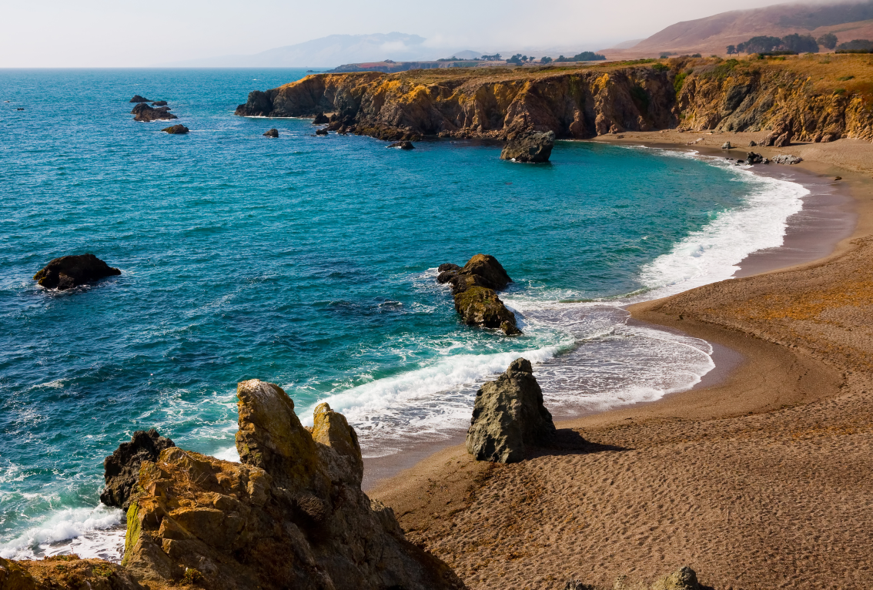
The 8 Recommendations will…
1. Address local factors that can reduce OAH exposure
2. Enhance ability of biota to cope with OAH stress
3. Expand knowledge about OAH
Many of these things are underway on the West Coast
Notes:
….they are organized this way to show there are things we can do on a local and regional basis to reduce additional stressors, and give marine species the best possible chance in the face of ocean acidification while continuing to grow with this nascent field. Some examples include:
Reducing the amount of nutrients going into the ocean
Reducing other stressors on ocean ecosystems, such as overfishing and pollution
Targeted research and smart monitoring on behalf of decisions.
7

Slide 8
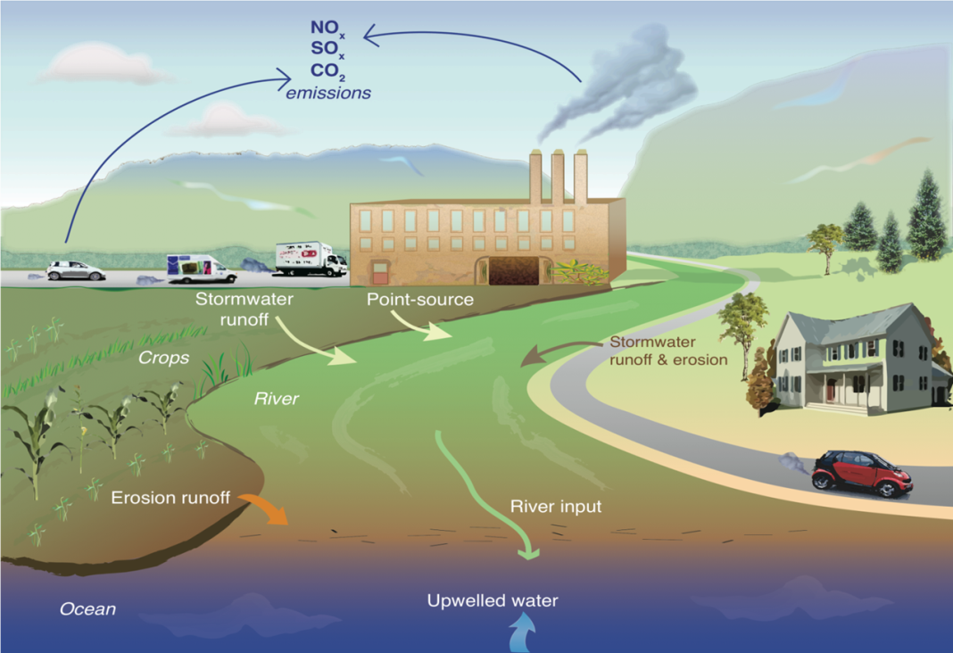
1. Act locally to lessen OAH exposure
Reduce local pollutant inputs that exacerbate OAH
Inventory areas where local pollution inputs are likely to exacerbate OAH
Predictive models of OAH and local source contributions
OPC has invested in a model, in partnership with NOAA, that investigates whether a noticeable improvement could be achieved by curbing pollution from coastal wastewater treatment plants, rivers and storm drains that have been shown to increase acidification. We can expand on such investments to better manage harmful OAH issues.
Modified after Kelly et al. (2011) Science
Notes:
Emphasis on OPC investment in the now West Coast wide OA and nutrients model
8

Slide 9
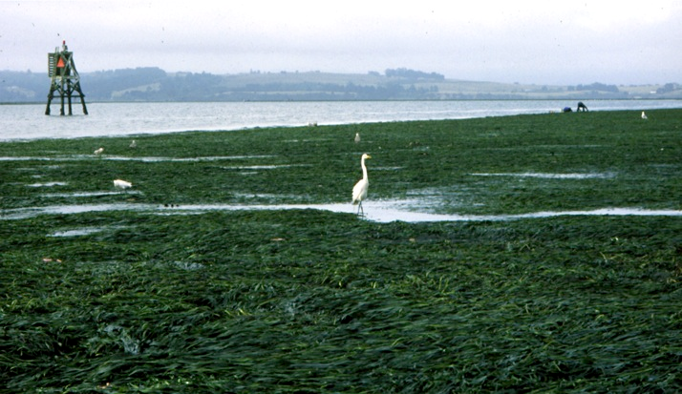
1. Act locally to lessen OAH exposure
Promote approaches that remove CO₂ from water
Implement new pilot projects to evaluate which locations are optimal for removing CO₂
Leverage existing wetland and eelgrass restoration projects to evaluate their effectiveness at CO₂ removal and to inform future planning strategies for CO₂ removal (carbon sequestration)
How can we leverage existing restoration projects and surveying and monitoring efforts, for example in Humboldt Bay (at right) which holds the vast majority of the state’s eelgrass, to think through CO₂ removal approaches and their effectiveness?

Slide 10
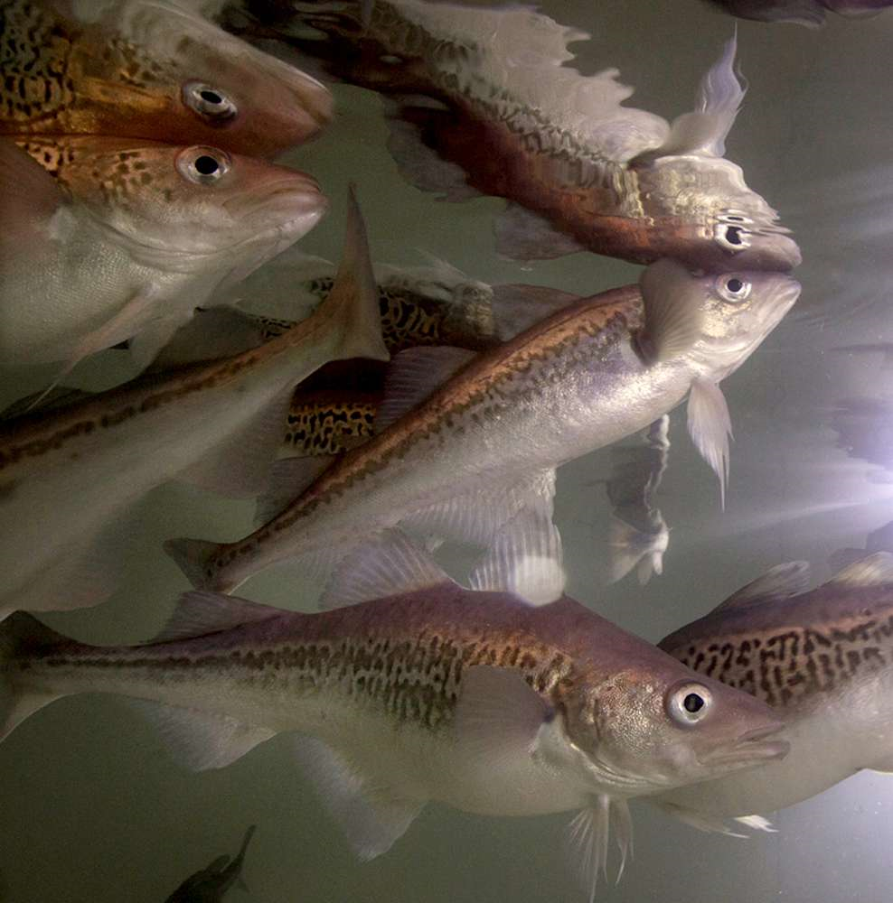
2. Enhance ability of biota
to cope with OAH stress
Reduce other stressors on ecosystems
Manage fishery resources with an eye towards OAH
OAH is likely to influence fisheries production along the West Coast via impacts on fish behavior, impaired calcification of prey items, and fundamental changes in food webs. California’s OPC Science advisory team is beginning a focused work group around climate change and fisheries. The group will address:
Evaluating the effects of changing climate and ocean chemistry on fisheries
Managing risk and uncertainty; and
Understanding and promoting the adaptive capacity of fishing communities
Notes:
We will need to design adaptive decision processes that can incorporate and respond to changing climate conditions. Effective management of fisheries in a changing climate will require increased coordination and responsiveness of both science and management to changing and perhaps unexpected conditions.
Managers should work to understand and incorporate the probable impacts of OAH into fisheries management plans.
it is important for West Coast managers to consider management plans and actions in the context of these multi-stressor effects. In particular, the growing adoption of ecosystem approaches to fisheries management offers opportunities to consider the potential regional effects of OAH as fisheries management plans are updated.
10

Slide 11
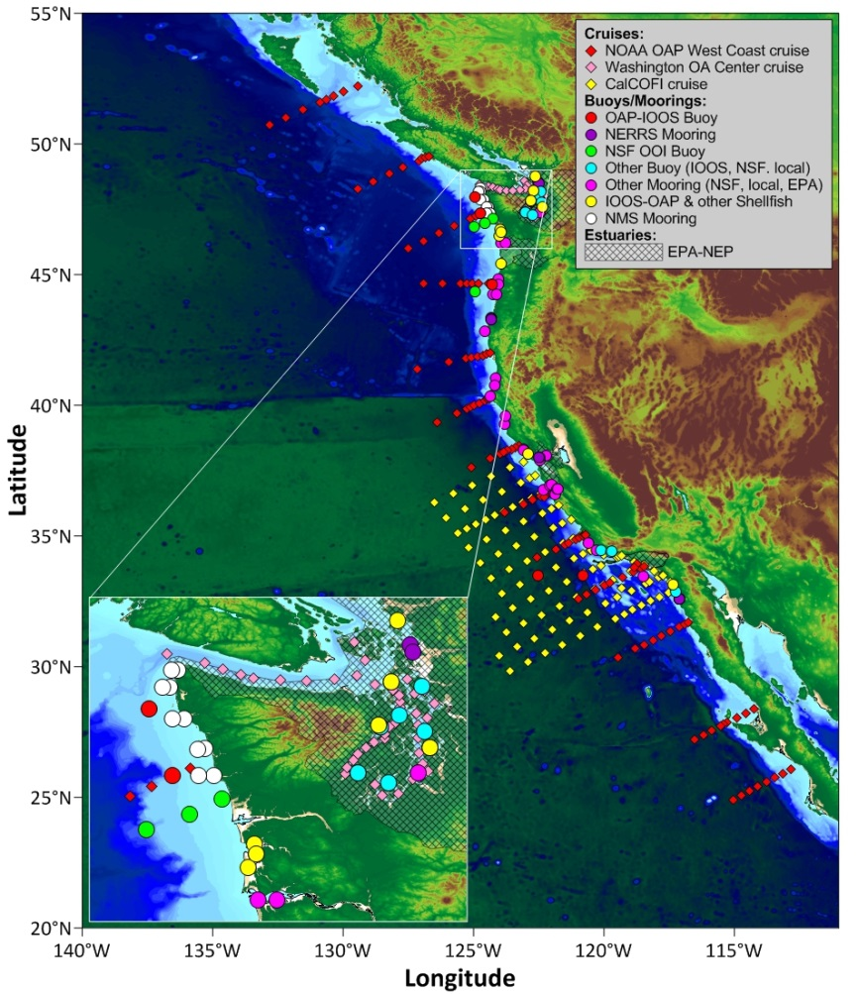
3. Expand knowledge about OAH
Local action now is important, but it is equally important that we set aside time and resources to continue to grow our knowledge in this young field, and respond quickly to the new knowledge. For example, this means:
Aligning federal and state monitoring efforts, both locally and region wide
Investing in relevant science and research
Figure: Current inventory of state and federal OA monitoring assets (buoys, moorings and cruises) as of January 2016.
Notes:
EXPAND KNOWLEDGE
Build flexibility and adaptability into conservation decisions.
Recommendation 7: Build out a West Coast monitoring program that meets management needs
Action: Define gaps between monitoring efforts and management needs
Action: Enhance comparability and access of OAH data

Slide 12
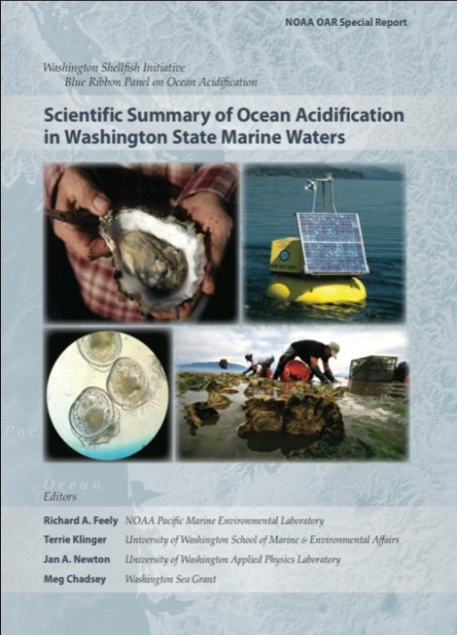
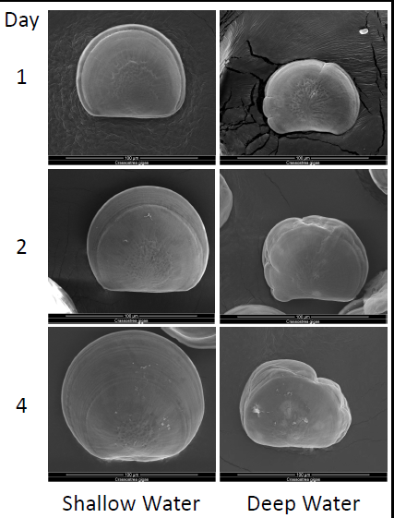
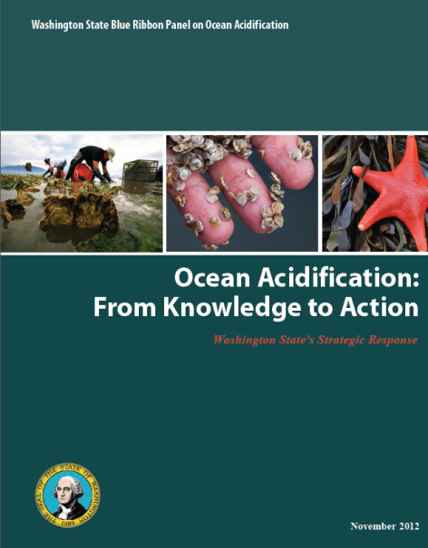
A Success Story
In 2007-08, millions of oyster larvae died in hatcheries in WA and OR
WA responded with the Blue Ribbon Panel on Ocean Acidification and legislation
Shellfish industry and coastal communities are adapting
CONTROL
ACIDIFIED
Notes:
Collaboration led to adaptation efforts.
Blue Ribbon Panel was in direct response to this particular issue, focused around the impacts of ocean acidification in WA waters.

Slide 13
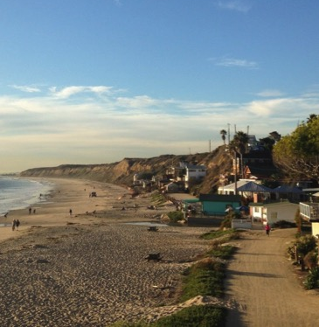
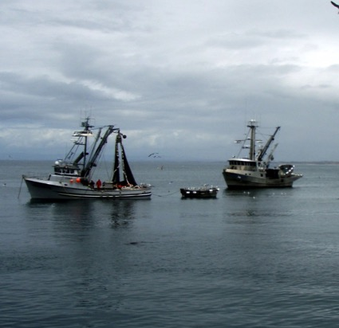
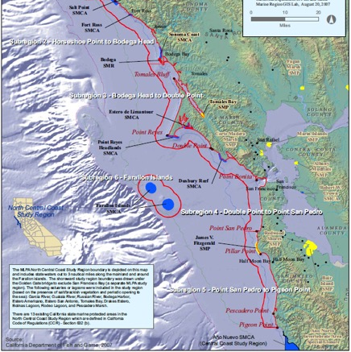
Today marks a critical starting
point for California
We need to consciously take these recommendations and make them actionable.
This means we need a roadmap for implementing the recommendations and involving state agencies.
This will ideally result in legislative guidance on transitioning from the recommendations to action.
Notes:
In the next year, we should work towards legislation that can cross and benefit all three states and build on efforts of the Panel recommendations
I encourage you to work with state legislature in WA or OR
Learn from what we saw in WA in order to get legislation in CA that recognizes our unique perspectives and parameters

Slide 14
Thank you
It is a privilege to provide you the summary of our scientific knowledge, and how it relates to action.
Acidification and hypoxia are the defining ocean issues for our generation.
Today we have presented an initial game plan to buy time and to minimize the damage and losses from being as extensive as they would be without intervention.
Keep in touch:
Jenn Phillips
jennifer.phillips@resources.ca.gov
Notes:
Just like a person trying to stay alive while waiting for an organ transplant, we can buy time while we learn more, or develop alternative ways to address changing ocean chemistry.

