Slide 1
SB 863 Overview and UpDate
Christine Baker, Director, DIR
Destie Overpeck, Acting Administrative Director, DWC
Rupali Das, M.D., Executive Medical Director, DWC
George Parisotto, Acting Chief Counsel, DWC
March 25, 2015

Slide 2
Why SB 863?
PD benefits had been cut by more than 50% as a result of SB 899 (2004)
Delivery of medical treatment:
  employees complained of delays and denials of care
  employers complained of runaway cost and the inability to block unnecessary medical treatments
Delays in dispute resolution
Costs in CA remained among the highest in the nation

Slide 3
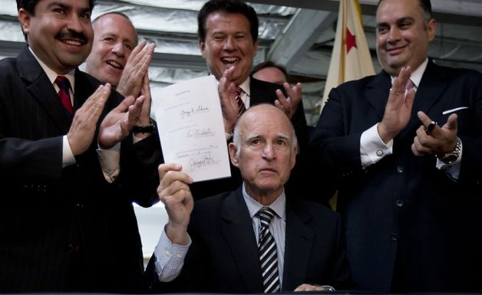
Senate Bill 863:
Workers’ Compensation Reform 2012
Bipartisan bill
Labor-management negotiation
Guiding principles
  Restore PD benefits
  Improve access to appropriate medical care
  Reduce costs for employers
  Where possible, increase system efficiency

Slide 4
Overview of SB 863 Changes
Reimbursement for services
  Independent Bill Review (IBR)
  Fee schedules
  Liens
Other
  Supplemental Job Displacement Voucher
  Return-to-Work Fund
  Self Insured Employers
Permanent Disability
Medical Treatment
  QMEs/AMEs
  Utilization Review
  Independent Medical Review (IMR)
  Medical Provider Networks (MPN)

Slide 5
Permanent Disability Benefits
PD benefits increase a main focus of statute
  Prior to 1/12, max weekly rate was $230 – 270 for most severe (70-99% PD rating)
Approx 30% increase occurred in two steps
  DOI on/after 1/1/13
  DOI on/after 1/1/14 – max increased to weekly rate of $290
  Rating formula modifier now 1.4 (used to be 1.1 – 1.4) represents diminished future earning capacity
Notes:
Prior to 1/12, min = $130, max = $230 – 270 for most severe (70-99% PD rating)
Now, Min = $160, max = $20 (phased on over 2 years)
Rating formula modifier now 1.4 (used to be 1.1 – 1.4) represents dimished future earning capacity
Examples: for worker who earns more than $435 per week
Total loss of vision in 1 eye 2005-2012: $19, 665 DOI 2013: $27,312.50 DOI 2014: $34,437.50
Amp of index finger (mid pt) $6,210 $7877.50 $9932.50

Slide 6
DWC Regulations

Slide 7
SB 863 signed 9/18/12, effective 1/1/13 -
25 Sets of Regulations Needed
SB 863 required 16 sets of implementing regulations:
  11 SB 863 sets of regulations have been completed
  6 emergency SB 863 regulations were in effect by 1/1/13
  Copy service fee schedule pending approval with OAL
  4 other SB 863 sets of regulations (including RTW) in process
  Ambulatory surgery center (ASC) regulations save $80M per year
  Reduction of spinal implant duplicate payment saves $110M per year
  Lien filing fee regulations save $690M per year (WCRIB)
9 additional sets of regulations completed or in process including Medical Treatment Utilization Schedule (MTUS) and Qualified Medical Evaluator (QME) online panel request process

Slide 8
SB 863 Implementation | Status | Results | Effective Date Per Labor Code
Ambulatory Surgery Center (ASC) LC § 5307.1 | Completed Regulations effective: 1/1/13 | WCIRB 2/14: 26-28% decrease in ASC costs ($80 M) | Jan. 1, 2013
Spinal Implant (Inpatient Fee Schedule) LC § 5307.1 | Completed Regulations effective: 1/1/13 | WCIRB 2/14: 56% fee reduction; reduced incentives ($110 M) | Jan. 1, 2013
Interpreter Certification Gov’t Code §§ 9795.1 et seq. LC §§ 4600, 5811 | Completed Emergency regs effective: 1/1/13 Regulations effective: 8/13/13 | CCHI and National Board certification tests for medical | Jan. 1, 2013 Extended to 3/1/14 per AB 1376

Slide 9
SB 863 Implementation | Status | Results | Effective Date Per Labor Code
Lien filing fees and e-document filing LC §§ 4903.05, 4903.06 | Completed Emergency regs effective: 1/1/13 Final regulations effective: 12/16/13 | 54 - 60% less lien filings $61.7 M lien fees collected as of 3/15 WCRIB: $690 M savings a year | Jan. 1, 2013 (Preliminary injunction prohibits activation fee)
IBR; Paper and Electronic Billing LC §§ 139.5, 4603.2, .3, .4, .6, 4622 | Completed Emergency regs effective: 1/1/13 Final regulations effective: 2/12/14 | 3,115 IBR applications rec’d as of 1/28/15 | For dates of service on or after Jan. 1, 2013
IMR, UR (including RFA form) LC §§ 139.5, 4610, 4610.5, 4610.6 | Completed Emergency regs effective: 1/1/13 Final regulations effective: 2/12/14 | 312,377 IMR applications rec’d as of 2/15 39,212 open IMR requests (13% of total) | For injuries on or after Jan. 1, 2013; For decisions communicated on or after July 1, 2013

Slide 10
SB 863 Implementation
SB 863 Implementation | Status | Effective Date Per Labor Code
QME LC §§ 139.5, 4610, 4610.5, 4610.6 | Completed Emergency regs effective: 1/1/13 Final regulations effective: 9/16/13 | For injuries on or after Jan. 1, 2013; For decisions communicated on or after July 1, 2013
SJDB LC §§ 4658.5, 4658.6, 4658.7 | Completed Emergency regs effective: 1/1/13 New forms effective: 1/1/14 | Jan. 1, 2013
Physician Fee Schedule (RBRVS) LC § 5307.1 | Completed Regulations effective: 1/1/14 | Jan. 1, 2014
Predesignation/ Chiropractor PTP LC § 4600 | Completed Regulations effective: 7/1/14 | Jan. 1, 2014

Slide 11
SB 863 Implementation | Status | Next Steps | Effective Date Per Labor Code
MPN LC §§ 9767.5.1 and 9767.16.5 - 9767.19 | Completed | Regulations effective: 8/27/14 | Jan. 1, 2013
Copy Services Fee Schedule LC § 5307.9 | Pending with OAL for review and approval | OAL’s review ends 4/30 Expect 7/1/15 effective date | Dec. 31, 2013
Interpreter Fee Schedule LC § 5811 | Study completed Post draft regulations on DWC forum this week | Begin formal rulemaking | Jan. 1, 2013

Slide 12
SB 863 Implementation | Status | Next Steps | Effective Date Per Labor Code
Home Health Care Fee Schedule LC §§ 4600, 5307.8 | RAND study posted: 1/27/15 Public meeting: 3/3/15 | Post draft regulations on DWC forum | July 1, 2013
Benefit Notice Regulations LC §138.4 | Public hearing: 9/3/14 | Issue revisions for 15-day comment period
Return to Work Supplemental Program LC § 139.48 (DIR regulations) | Public hearings: 12/8 and 12/9/14 15-day comment period: 3/17/15 | Review comments and submit to OAL

Slide 13
Additional Regulations
Additional Regulations | Status | Next Steps
OMFS – Hospital Outpatient and ASC | Completed | Regulations effective 9/1/2014
OMFS - General | Completed | Regulations effective 3/5/15
ICD-10 Codes in billing guides Audit Regulations LC § 129.5 | Completed | Regulations effective 10/1/14

Slide 14
Additional Regulations | Status | Next Steps
Medical Treatment Utilization Schedule (MTUS) – Strength of Evidence LC § 5307.27 | Pending with OAL for review and approval | OAL’s review ends 4/20/15
MTUS – Opiods and Chronic Pain LC § 5307.27 | Opiod guideline on DWC forum: 4/21/14 Chronic Pain guideline on DWC forum: 12/18/14 | Begin formal rulemaking
WCIS medical bill reporting LC § 138.6 | Pending with OAL for review and approval | OAL’s review ends 4/6/15

Slide 15
Additional Regulations | Status | Next Steps
Audit Regulations LC § 129.5 | Preparing draft regulations | Post on DWC forum
QME On-line Panel Request LC §§ 4060, 4061, and 4062 | Posted on DWC forum: 9/22/14 Notice of rulemaking will issue: 4/3/15 | Public Hearing: 5/22/15
WCIS Penalties LC § 138.6 | Posted on DWC forum: 4/16/13 | Begin formal rulemaking

Slide 16
Utilization Review and Independent medical review

Slide 17
Pre-SB 863 QME Process for Medical Treatment Disputes took up to 18 months
UR denies tx
IW request QME panel (35 days)
Panel issues (30 -110 days, 72 days median for 2012)
QME schedules exam (60-90 days and an additional 30-60 days if rescheduled)
QME writes report (30 days plus 30 days extension for good cause)
Deposition of QME (120 days from notice of deposition)
QME issues supplemental report (60 days)
If parties disagree with report, file DOR with WCAB (20 days)
Hearing with WCJ
May be reviewed by to WCAB
WCJ issues order (30-90 days)
Parties strike names to choose QME (10 days)

Slide 18
Utilization Review
UR Denial, Delay, Modification
(5 days)
UR denial letter to IW along with completed IMR form
Provider fills out RFA form
Treatment Approved
Liability dispute
Defer UR until resolved
Independent Medical Review

Slide 19
IMR Highlights
  IMR applications are filed for between 1% and 5% of all medical treatment requests
IMR decisions are issued less than 30 days after receipt of complete medical records
The largest category of IMR requests are for medications
  42% of 2014 IMR decisions: pharmaceuticals
  26% of pharmaceutical IMRs: narcotic pain medications
Overturns UR decisions in 12% of final determinations
Disproportionately more IMR cases than injury claims were filed in Los Angeles, Inland Empire, Central Coast
Notes:
IMR applications are filed for between 1% and 5% of all medical treatment requests
--The vast majority of treatment requests in the workers’ compensation system are approved
Upholds UR decisions in 88% of FDLs

Slide 20
Independent Medical Review (IMR)
Replaces QME procedure
Medical expertise to resolve treatment disputes to provide timely, appropriate care for injured workers
IMR contractor is Maximus Federal Services
  Costs paid by the employer/claims administrator
    For applications after Jan. 1, 2015: $390
    Withdrawal fee: $123
  Not the Medical Provider Network IMR program

Slide 21
IMR Process
  Requested by injured worker/designee
    30 days from issuance of UR determination
  Complete IMR application requires:
    Signed, completed IMR Form
    May have authorized Representative
    Copy of UR determination letter
    Copy of application sent to claims administrator
  IMR may be terminated at any time if treatment is approved

Slide 22
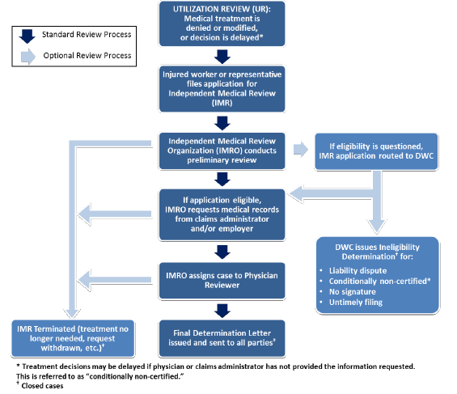
IMR Process - Decision issues within 30 days of assignment

Slide 23
Timeline: Complete IMR Request
UR delay/denial/modification
Up to 30 days*
IMR request submitted to MFS
MFS assigns to reviewer & requests medical records
Up to
50 days*
MFS issues determination

Slide 24
DWC Quality Assurance for IMR
Conduct oversight of program
  Continuous process improvements
  Track metrics and conduct data analysis
  Random review quality of final decisions
Provide transparency
  Redacted decision letters publicly available
    http://www.dir.ca.gov/dwc/IMR/IMR-Decisions/IMR_Decisions.asp
    Report issued in 2014
      http://www.dir.ca.gov/dwc/imr/reports/2014_IMR_Annual_Report.pdf.
  Educate stakeholders to improve quality of care for workers

Slide 25
Supporting DatA
For IMR Highlights

Slide 26
Most treatment requests are approved
550,000 – 650,000 new WC claims filed every year requiring medical treatment.
2014:
  26.2 million treatment request bills reported to DWC’s Workers’ Compensation Information System for 2013 date of service (all dates of injury).
  486,000 treatments disputed through IMR (high estimate)
    187,000 IMR applications, 145,000 IMR final determinations, 2.6 treatments per IMR letter.

Slide 27
2014 disputed treatments with IMR FDLs compared to 2013 paid medical bills

Slide 28
CWCI’s Data:
2014 Preliminary IMR Decision Results
Treatment Requests Approved vs Denied/Modified

Slide 29
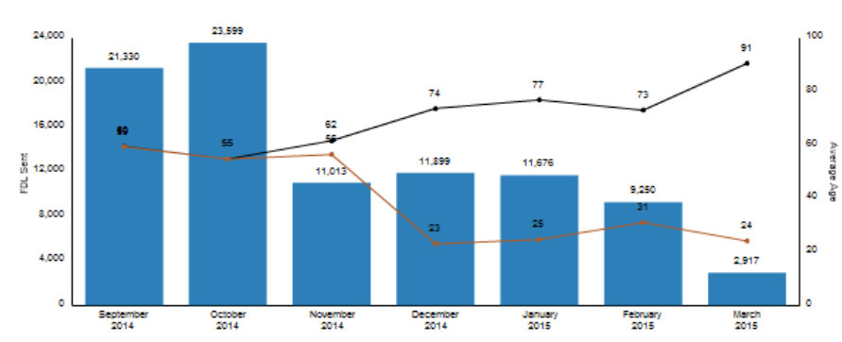

IMR Decisions Issued Less Than 30 Days After Medical Records Received
*Data available to date; March data is incomplete

Slide 30
2014 IMR: Pharmaceutical Issues Dominate
% Of All Treatment Decisions, N=275,476
Notes:
*Surgical issues include surgical procedures, pre- and post-operative care, and engagement of assistant surgeons.

Slide 31
2014 Pharmaceutical IMR Decisions:
Top Drug Classes, Random Sample
Random sample of 780 pharmaceutical IMR decisions from 2014.
Notes:
Results of random sample fairly consistent with 2013 analysis.

Slide 32
Outcomes in 2014 IMR
Final Determination Letters
2014 IMR Final Determination Letters, N=144,644
Notes:
Uphold: UR decision to not certify all treatment requests stands; treatments are not medically necessary
Overturn: UR decision to not certify all treatment requests is reversed; treatments are medically necessary
Partial Overturn: When there are multiple treatment requests and some are overturned while others are upheld

Slide 33
2014: More IMR Cases than Injury Claims in
Los Angeles, Inland Empire, Central Coast
Notes:
2014 Geographic Regions of Injured Workers in Closed IMR Cases and Claim Files in DWC’s Workers’ Compensation Information System (WCIS)*
* Total IMR cases closed by injured worker California postal code: 179,183; Does not include 8,789 out-of-state or unknown postal code IMRs. Total in state WCIS claims as of WCIS run date 3/17/2015: 552,793.

Slide 34
Additional Background information
For IMR

Slide 35
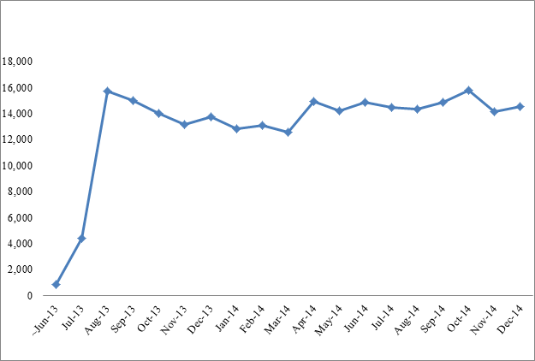
Monthly IMR Application Volume Steady
Notes:
Apps. 2013 76,931
Apps. 2014 170,834
Total 247,765

Slide 36
2014 IMR Applications: 75% Unique

Slide 37
2014 IMR Applications: 62% Eligible

Slide 38
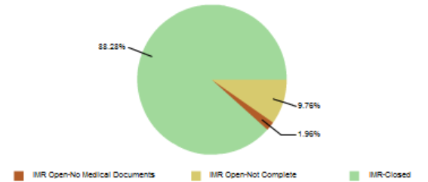
All IMR Applications: 88% Closed
Applications received January 1, 2013 through March 11, 2015
Notes:
Closed= Terminated, withdrawn, ineligible, FDL issued
336,223 applications received January 1, 2013—March 11, 2015

Slide 39
2014 IMR Closed Cases
Notes:
2014 Applications, N=170,834
2014 Closed Cases, N= 187,972
2014 IMR Final Determination Letters, N=144,644

Slide 40
Most Common Reason for Ineligible IMR:
UR Decision Not Submitted with Application

Slide 41
Average 2.6 Treatment Issues per
IMR Final Determination Letter
2014 Average 2.6 Issues per IMR with FDL
Max Issues for single IMR FDL 37
Notes:
CM14-0025752 had 37 Issues almost all

Slide 42
IMR Most Likely to Overturn UR For Evaluation and Management (Physician Consult)
Notes:
*Surgical issues include surgical procedures, pre- and post-operative care, and engagement of assistant surgeons.

Slide 43
Most Injuries Date from 2012, 2013
Closed IMR Applications
Notes:
Total IMRs Closed 2014: 187,972
31% from 2012, 2013
54% 2010-2014

Slide 44
2014 IMR Closed Cases:
70% of Filed by Representative
2014 Closed IMRs, N =187,972

Slide 45
Medical Specialties of IMR Physician Reviewers, 2013
IMR FDLs: 3,723
Notes:
N=3,723

Slide 46
IMR Provides Medically Necessary Care and Prevents Harmful Procedures
CM13-0054595: Overturn, detoxification program
CM14-0029944: Overturn, evaluation for function restoration program
CM14-0011989: Partial overturn, narcotic analgesic
CM14-0049819: Uphold, lumbar fusion

Slide 47
Independent Bill Review (IBR)

Slide 48



IBR Process – Decision issues within 60 days of Assignment
Second Bill Review
by claims administrator if dispute over amount paid
Provider files for Independent Bill Review (IBR) if dispute not resolved. Filed either by mail or online with $195 filing fee
Provider may consolidate similar requests for one decision
Maximus conducts preliminary review for eligibility
Initial Bill Submission
for medical treatment or medical-legal services
Ineligibility Determination for:
Incomplete application
No payment of fee
No second bill review
Dispute not under fee schedule
Service not authorized
If eligible, Maximus requests response from claims administrator
IBR may be withdrawn by provider if dispute resolved
Maximus receives documents from claims administrator
Maximus assigns eligible case to Coding Expert
Final Determination Letter
Fee reimbursed if provider prevails

Slide 49
IBR Applications, 2013 - 2014
IBR Applications Through December 2014: N=2,969

Slide 50
IBR: Physician Service Most Common
IBR Applications Through December 2014: N=2,969

Slide 51
IBR Decisions with a Single Service: Most Decided in Favor of Provider
1439 out of 1952 IBR decisions thru December 2014 disputed payment for a single service
Notes:
Total 2013-2014 IBR Decisions: 1,952 (623 Upheld, 1,329 Overturned)

Slide 52
Average IBR Award Varies by Service

Slide 53
Medical Treatment Utilization Schedule
Update Plans

Slide 54
Update Plans
  Evaluating Medical Evidence
  Guideline for the use of opioids to treat non-cancer pain
  Guideline for the treatment of chronic non-cancer pain
  Other clinical topics and “body chapters”

Slide 55
Resources
Independent Medical Review
  http://www.dir.ca.gov/dwc/IMR.htm
Frequently Asked Questions
  http://www.dir.ca.gov/dwc/IMR/IMR_FAQs.htm
Regulations
  http://www.dir.ca.gov/dwc/DWCPropRegs/IMR/IMR_Regs.htm
Forms
  http://www.dir.ca.gov/dwc/forms.html
DWC Medical Unit
  http://www.dir.ca.gov/dwc/MedicalUnit/imchp.html

