Slide 1
Putting Taxis and TNCs in Context Considerations for the Public Sector 17 February 2016
Brian D. Taylor, PhD, FAICP
Professor of Urban Planning
Director, Institute of Transportation Studies
Director, Lewis Center for Regional Policy Studies
UCLA Luskin School of Public Affairs

Slide 2
Transportation Research Board of the National Academies of Science, Engineering, and Medicine
Convened committee of experts to examine the rise of smartphone-based mobility services
Committee formed, vetted, and began work in June 2014

Slide 3
Committee Members
Brian Taylor, UCLA (chair)
Ryan Chin, MIT
Melanie Crotty, San Francisco Bay Area MTC
Jennifer Dill, Portland State University
Lester Hoel, University of Virginia
Michael Manville, Cornell University
Steve Polzin, University of South Florida
Bruce Schaller, Consultant
Susan Shaheen, UC Berkeley
Daniel Sperling, UC Davis
Marzia Zafar, California Public Utilities Commission
Susan Zelinski, University of Michigan

Slide 4
Committee Members
Brian Taylor, UCLA (chair)
Ryan Chin, MIT
Melanie Crotty, San Francisco Bay Area MTC
Jennifer Dill, Portland State University
Lester Hoel, University of Virginia
Michael Manville, Cornell University
Steve Polzin, University of South Florida
Bruce Schaller, Consultant
Susan Shaheen, UC Berkeley
Daniel Sperling, UC Davis
Marzia Zafar, California Public Utilities Commission
Susan Zelinski, University of Michigan

Slide 5
Committee Overview
Committee members had expertise in:
Urban planning and transportation policy
Transit and shared use services
Regulatory and economic analysis
Transportation operations and technologies
Taxi operations and regulations
Held 4 two-day meetings in 2014 and 2015 to gather information and draft the report

Slide 6
Information Gathering
Committee staff reviewed journalistic and scholarly inquires
Relatively little of the latter
Committee heard from:
Representatives of the taxi industry
Firms and regulators
Uber and Lyft
Carsharing operators
Insurance providers and regulators
City council members
Developers of other innovative services
Public transit representatives

Slide 7
Presentations Roadmap
Brian Taylor
Overview of taxi and TNC economics
Drawing on work by committee member Michael Manville
Brief comments on several public policy issues examined in report
Committee Recommendations (at the end)
Susan Shaheen
New mobility services: Implications for travel behavior
Bruce Schaller
The future of the taxi industry in a post-TNC world

Slide 8
Where is this all headed? 2 Views
This is the tip of the iceberg
Real-time decision-making about trips, options, time provides quick, reliable, convenient ride service
Fare reductions and shared rides will accelerate current growth
The sky is the limit
Big changes, but for a niche market
The changes are significant for a few people, but not widespread changes in travel

Slide 9
From ridesharing to for-hire transport, information is a big challenge
Getting a ride from someone else requires lots of information
Coordination
When/where will the rider & driver meet up, where will they go?
Negotiation
Can the rider & driver agree on terms?
Trust
Will rider and driver be safe sharing a ride?
Regulation has emerged over the years to address each of these information problems

Slide 10
Why TNCs Thrive
Peer-to-Peer app reduces information costs and upfront entry costs
Driver provides the vehicle in response to market demand
App removes need for dispatch service
Real time information for both driver and passenger
Driver/vehicle picture and ratings
Cashless transaction, digital footprints for trip
Information gleaned from all app users goes into setting real-time prices that can minimize shortages

Slide 11
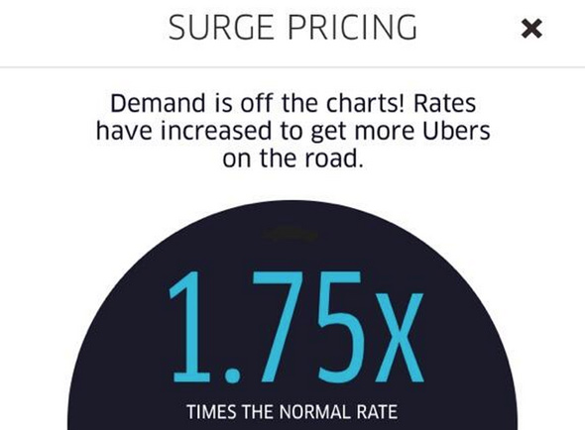
What Surge Pricing Does
Price and supply vary with demand
No price controls
No quantity or location controls
Flexible employment means large pool of potential drivers on reserve
Rising prices both increases supply and moderates demand

Slide 12
Could TNCs Become Monopolists?
Uber and Lyft have significant market power
But it may be difficult for them to restrain competition
Low entry barriers
People can drive for multiple firms

Slide 13
Security and Public Safety
New services provide more information for both passengers and drivers
“Closer” to safety outcomes than vetting
This can increase safety for both drivers and passengers
The effectiveness of various approaches to driver vetting has been curiously understudied
Determining the most cost-effective approaches to driver vetting requires more study
Consistency across services is desirable

Slide 14
Labor Issues
Number of drivers is growing rapidly
Growth in part-time drivers in new services
Income and benefits can vary greatly
Limited employment security and benefits is common across the for-hire ride industries
Independent contractors vs. employees
These labor issues are economy-wide, transcending shared mobility services

Slide 15
Insurance issues
Taxis typically have full-time commercial coverage
TNC coverage generally varies by stage of the ride
Insurance products available tend to lag the evolution of mobility services
But are starting to catch up

Slide 16
Equity and Access
Four Dimensions of Equity in Public Policy Debates over Technology-Enabled Mobility Services
Equity Dimension | Issues Raised
Firms, markets, and competition | Market dominance, unfair competition, regulatory capture
Regulations, subsidies, and social services | Regulatory consistency, public subsidy of winners and losers, social service transportation obligations
Geographies and jurisdictions | Service in high- versus low-demand areas; service in poor, minority neighborhoods
Stakeholder groups | People without smartphones, “unbanked” populations, workers, etc.

Slide 17
Committee Recommendations

Slide 18
Committee Recommendations
Reassessment of regulations for all for-hire vehicle services is likely needed
market entry
geographic coverage
span of service

Slide 19
Committee Recommendations
Public safety requirements should be consistent across each type of service (street hail/taxi stand, dispatch/app) and gauged to risks

Slide 20
Committee Recommendations
Policy makers and regulators should consider whether TNC and taxi services may be better regulated at the state, regional, or local level, while ensuring consistency and effective enforcement

Slide 21
Committee Recommendations
Systematic evaluations of safety requirements are needed

Slide 22
Committee Recommendations
Accessibility of services to all travelers should be a priority

Slide 23
Committee Recommendations
Basic service information for effective planning and regulation should be required of all mobility services

Slide 24
Committee Recommendations
Employment classifications need to be carefully assessed

Slide 25
Committee Recommendations
TNCs and other innovative services should be integrated with existing transportation systems and planning

Slide 26
For additional information
Katherine Kortum Brian D. Taylor
Study Director Committee Chair
kkortum@nas.edu btaylor@g.ucla.edu
202-334-3123
Transportation Research Board
500 5th Street NW
Washington, DC 20001
www.trb.org

