Slide 1
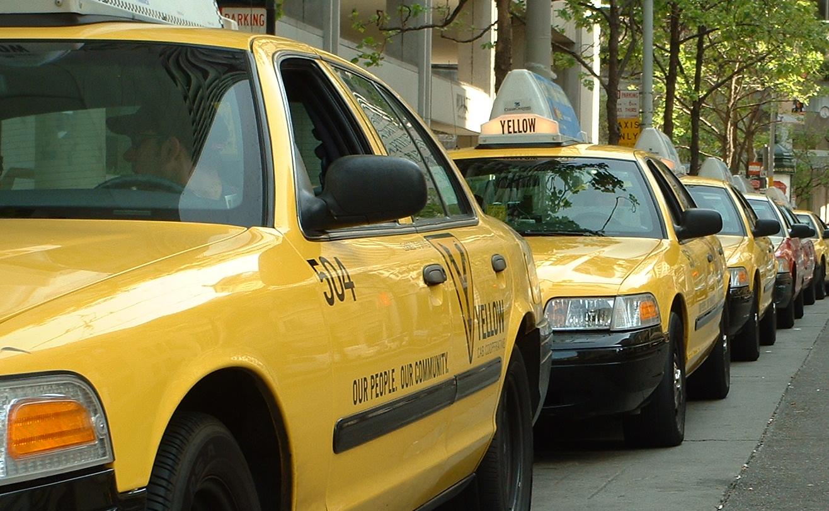
Implications for the Taxi Industry and Riders
Bruce Schaller
Principal, Schaller Consulting
February 17, 2016
California Senate Oversight Hearing

Slide 2
Ride Service Market is Expanding
42% increase in taxi & limo industry revenue from 2002 to 2012
(in billions, adjusted for inflation)

Slide 3
Ride Service Market is Expanding
32% increase in working taxi drivers & chauffeurs from 2000 to 2006-10 (5-year average)

Slide 4
What’s Happening with Taxicabs?
Declines in trips and revenues:
San Francisco 20-30%
Los Angeles 24%
New York City 19%
Boston 35%
Seattle 28%
St. Louis up to 40%

Slide 5
What’s Happening with Taxicabs?
Declines in trips and revenues:
San Francisco 20-30%
Los Angeles 24%
New York City 19%
Boston 35%
Seattle 28%
St. Louis up to 40%
COMPETITION
Uber
Lyft

Slide 6
Two Schools of Thought
TNCs, many customers, commentators and elected officials
Taxi industry, regulators
It’s the American way!
It’s unfair competition!
Better service
Technological innovation
Pricing matches supply and demand
Promotes urban lifestyles
Reduce DUI
Lower standards for criminal record checks and auto insurance
Wider choice of vehicles
Surge pricing
Uncontrolled entry
No requirements for geographic coverage, wheelchair-accessibility

Slide 7
What Should be Done?
TNCs, many customers, commentators and elected officials
Taxi industry, regulators
Regulatory response:
Cease-and-desist orders
Apply taxi regulations to TNCs
Ask for regulatory relief
TNCs need different regulatory model that fits their different business model
Competitive response:
Taxi apps
Friendlier drivers and better-kept vehicles

Slide 8
TRB Report 319 calls for…
Encourage and facilitate innovations that meet mobility needs
Ensure fair competition between taxis and TNCs

Slide 9
“Unlevel” Playing Field
Taxis
TNCs
Fleet size
Set by regulation
Set by TNC
Price
Set by regulation
Set by TNC
Geog. controls
Limited to city/zones
None; operate statewide
Taxi stands
Authorized to pick up
Limited to dispatch trips
Driver safety
Gov’t background checks
TNC background checks
Vehicle safety
Gov’t standards/inspections
TNC standards/gov’t inspec.
Veh. insurance
Commercial, 24/7
Varies by “period”
Service quality
Mix of gov’t standards and
customer choice
Customer choice
Notes:
Critical distinction for managing growth of:
Concurrent shared rides (strangers in cab together)
Microtransit
Self-driving cars
Data – mention Session 800

Slide 10
Recommendations for Fair Competition
Issue
Recommendation
Entry controls
Pricing
Examine minimum regulation necessary (greater for hail/stand trips)
Driver background checks
Insurance requirements
Be consistent across each type of service (taxi stand, dispatch)
Systematic evaluation, gauged to risk
Wheelchair-accessible service
Ensure access through regulation, incentives, mandates and/or subsidies
Apply across each type of service
Regulatory authority
Balance benefits uniformity and responsiveness to local needs
Ensure on-the-ground regulatory enforcement
Notes:
Critical distinction for managing growth of:
Concurrent shared rides (strangers in cab together)
Microtransit
Self-driving cars
Data – mention Session 800

Slide 11
… Implications for Regulation
Match scope of regulation to level of competition and user choice:
Dispatch operations
Street hail/taxi stand trips
Airport-originating trips
Control entry and fares only for hail/stand part of the service
Set background check and insurance requirements using risk-based analysis focused on outcomes
Find innovative ways to serve higher-cost trips (addressing wheelchair accessibility and digital divide)
Ensure consistency and coordination between taxi and TNC regulation
Vision where everyone could be both driver and passenger

Slide 12
Goals of Regulatory Framework
Flexibility:
Compete on service quality
Compete on selection
Compete on price
Openness:
New services
New service providers
Accountability:
Government
Consumers
Prevent abuses
Monopoly power, predatory pricing, deceptive practices, illegal practices to distort how the market works
Serve goals of mobility, economic efficiency and equity

