Slide 1
Interagency Refinery Task Force (IRTF)
History
Triggered by Chevron Richmond fire (August, 2012)
Governor designated Interagency Working Group on Refinery Safety (draft report July, 2013)
Issued “Improving Public and Worker Safety at Oil Refineries” (final report February, 2014)
http://www.calepa.ca.gov/Publications/Reports/2014/RefineryRpt.pdf
http://www.calepa.ca.gov/Publications/Reports/2014/RefinerySp.pdf
Governor directed CalEPA to create IRTF (August, 2013)

Slide 2
IRTF Members
Organizations in red indicate present this evening
California Environmental Protection Agency
California Air Resources Board
Department of Toxic Substances Control
State Water Resources Control Board
Department of Industrial Relations Division of Occupational Safety and Health
Governor’s Office of Emergency Services
California Department of Public Health
California Emergency Medical Services Authority
Office of the State Fire Marshal
U.S. Environmental Protection Agency Region 9

Slide 3
IRTF Members (cont.)
Certified Unified Program Agencies with refineries
Contra Costa County Environmental Health
El Segundo Fire
Kern County Environmental Health
Los Angeles County Fire
City of Los Angeles Fire
San Luis Obispo County Environmental Health
Solano County Environmental Health
Local Air Pollution Control Districts with refineries
Bay Area Air Quality Management District
San Joaquin Valley Air Pollution Control District
San Luis Obispo County Air Pollution Control District
South Coast Air Quality Management District

Slide 4
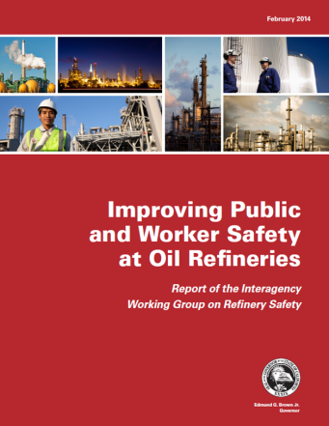
Recommendation Categories
Emergency management and response
Safety and prevention
Public education and outreach
Improved agency coordination through the establishment of an Interagency Refinery Task Force
www.calepa.ca.gov/refinery

Slide 5
IRTF Current Areas of Focus
Three Work Groups
Safety and Prevention
Emergency Preparedness and Response
Enforcement Coordination
Community Education and Alerts

Slide 6
Safety Forums
“Establish forums in northern, central, and southern California for ongoing dialogue among industry, labor, community, environmental groups and regulators…
[Focusing…] on joint learning, sharing of good process safety practices among California refineries, examination of performance metrics, root cause analysis of incidents, and other issues proposed in this report for further evaluation. “
Improving Public and Worker Safety at Oil Refineries

Slide 7
Hierarchy of Controls
Inherent Safety
Safety Culture Assessments
Damage Mechanism Hazard Reviews
Root Cause Analysis
Human Factors

Slide 8
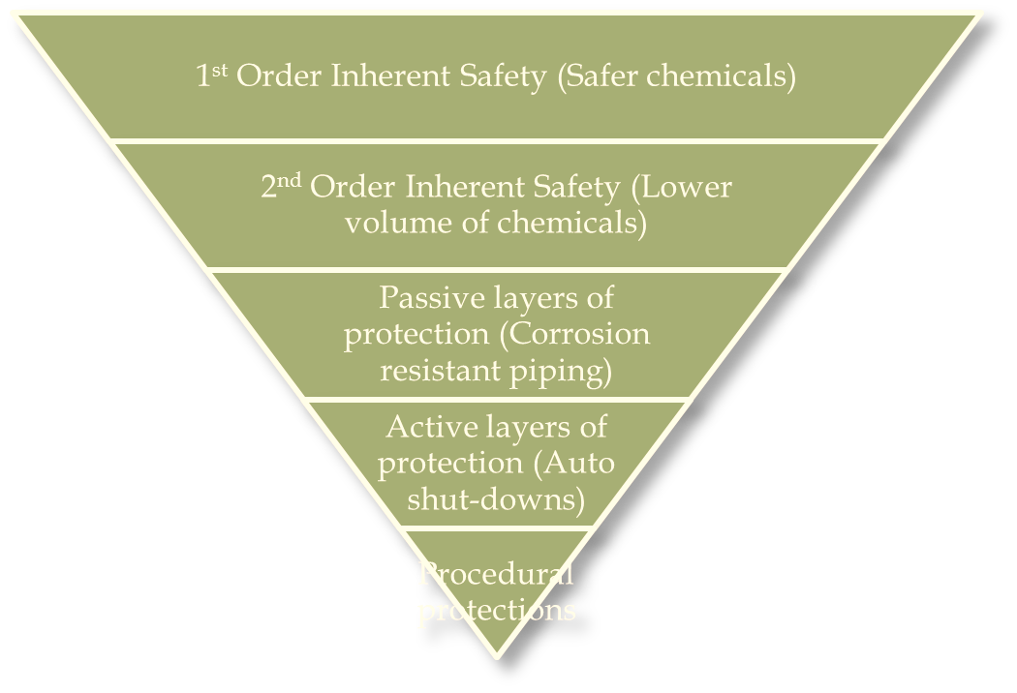
Hierarchy of Hazard Control
Hierarchy of Hazard Control: Hazard prevention and control measures, in priority order, to eliminate or minimize a hazard.

