Slide 1
Wildfires, Vegetation Management and Powerlines
Presented to Senator Hill and Committee
November 2015
David L. Geier
VP – Electric Transmission & System Engineering
San Diego Gas & Electric
DGeier@semprautilities.com
© 2012 San Diego Gas & Electric Company. All copyright and trademark rights reserved.

Slide 2
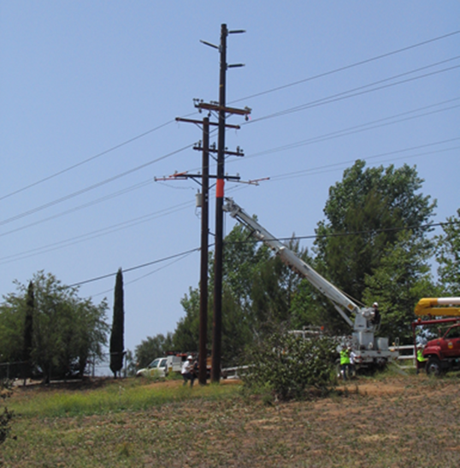
Comprehensive Program to Reduce Fire Risk
Extensive engineering changes (more stringent design criteria, use of fire-resistant materials, use of state-of-the-art equipment)
Weather monitoring and forecasting
Aggressive vegetation management program
Expanded QA/QC inspection and repair program
Escalating operational changes coincident with conditions
Far reaching community outreach and involvement
Pole Replacements – FiRM, Cleveland National Forest, Wood to Steel

Slide 3
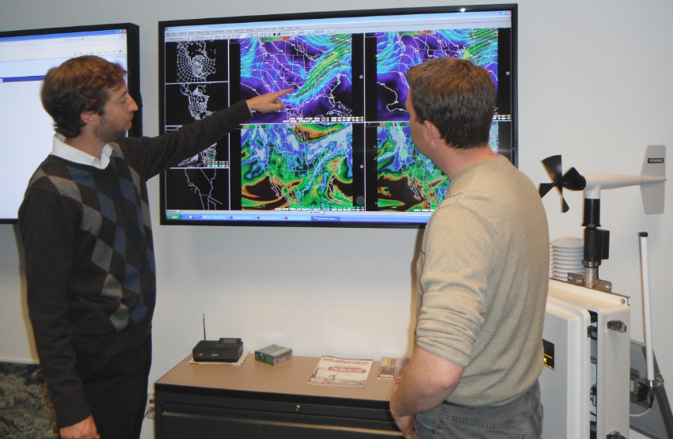
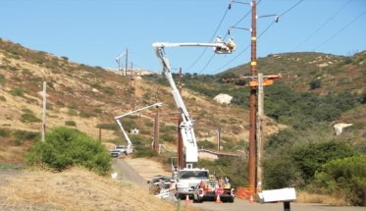
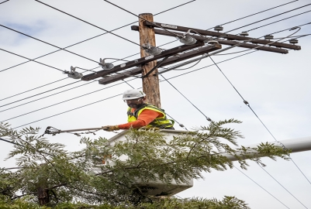
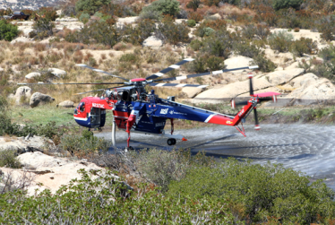
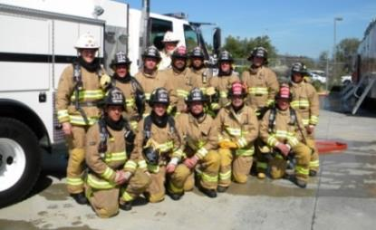
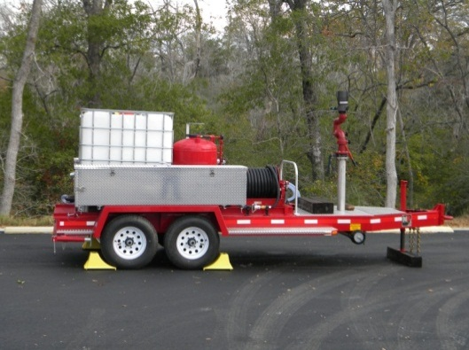
Reducing Wildfire Risks
Meteorologists and Fire Coordination
Wood to Steel Conversion
Vegitation Management
Air Support Contract
Contracted Fire Fighters
Mobile Fire Trailers
Updated Operational Procedures

Slide 4
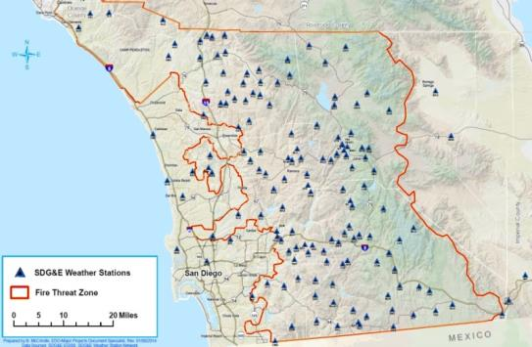
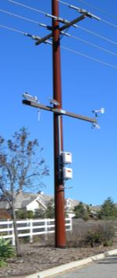
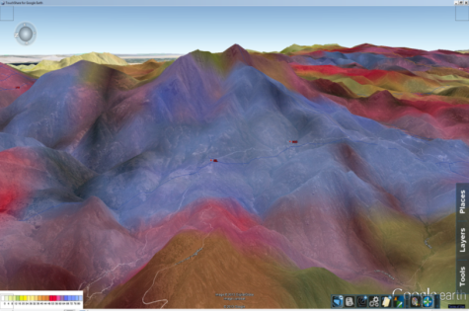
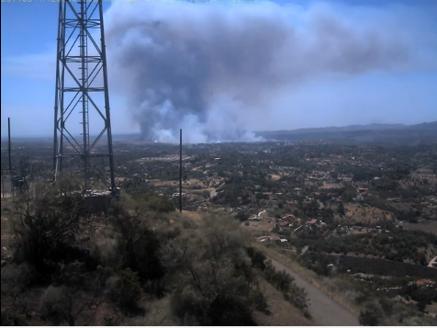
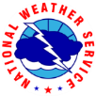
Situational Awareness Enhancements through Community Collaborations and Big Data
SDG&E Weather Station Network: largest utility weather network in the world delivering unsurpassed real-time decision support
State-of-the-Art Forecasting System: Provides superior understanding of weather and vegetation moisture supporting proactive emergency operations
Mountain top camera network allows for real time monitoring of hazardous conditions providing updated intelligence
Collaboration with key stakeholders in the local fire community increasing data sharing

Slide 5
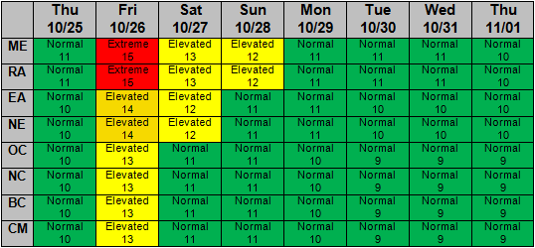
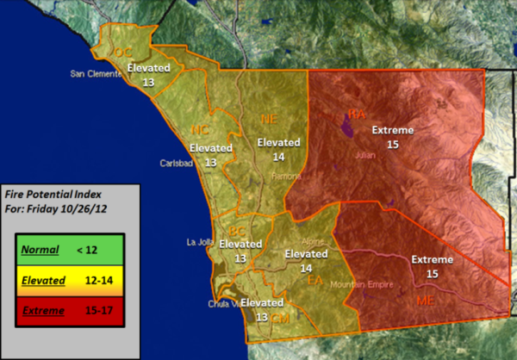
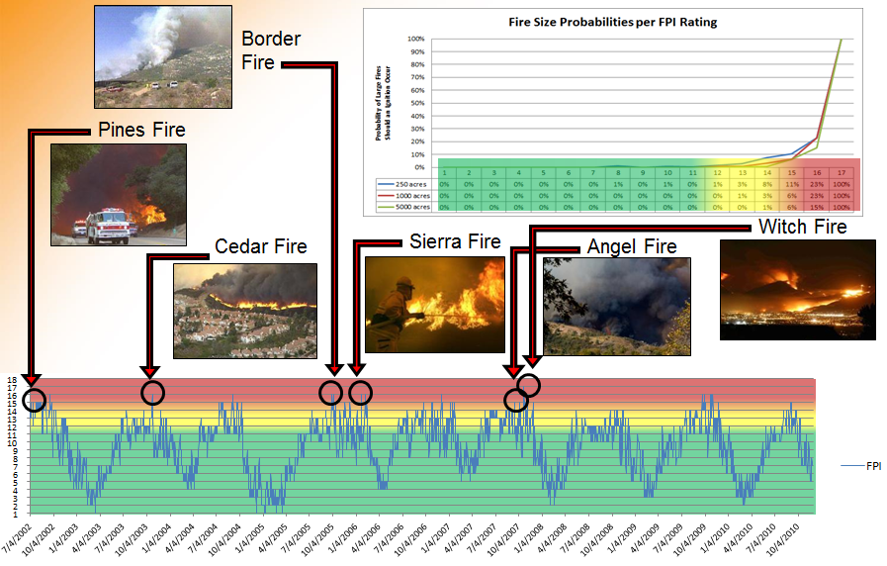
FPI
Developing Operational Tools - Fire Potential Index (FPI)
The Fire Potential Index is a planning and decision support tool designed to reduce the risk of a wildfire while improving efficiency and reliability

Slide 6
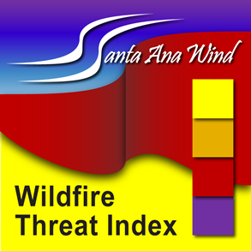
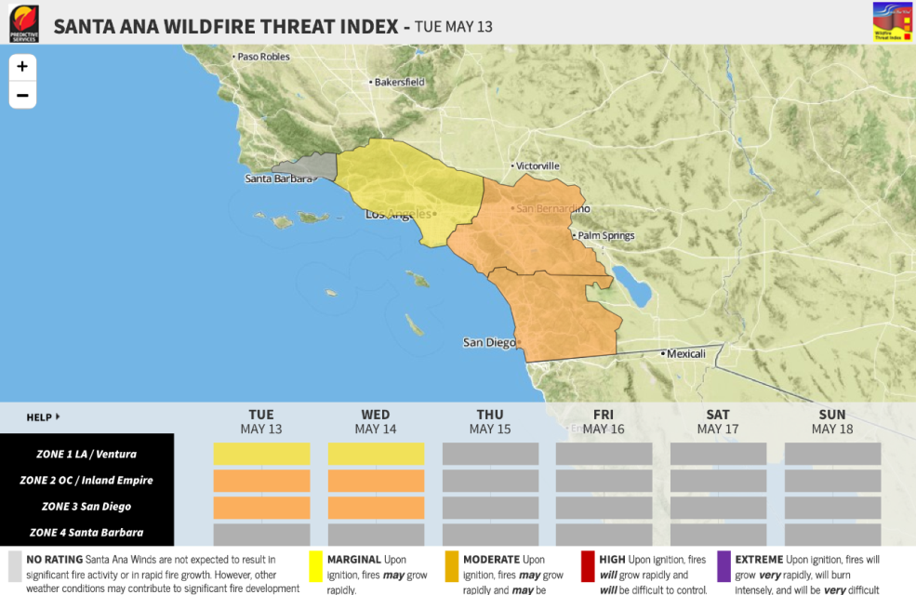
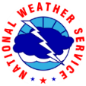
SAWTI
Developing Operational Tools - Santa Ana Wildfire Threat Index (SAWTI)
Our Mission: Develop a tool to mitigate risks associated with extreme fire potential during Santa Ana Winds.
Our Vision: To provide a
decision support tool to fire
agencies and the general
public to increase public
safety and overall
preparedness.

Slide 7
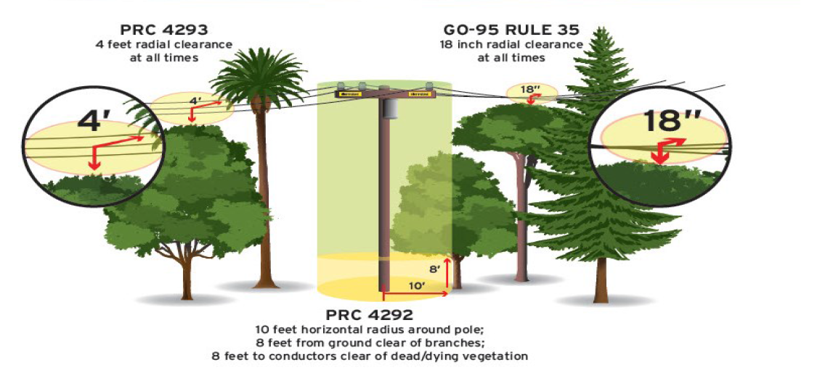
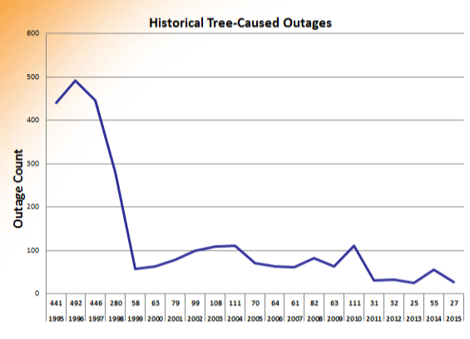
Vegetation Management Program
SDG&E Vegetation Management maintains a comprehensive database of over 464,000 trees that could impact our system.
Includes tree location, species, growth rates and pruning history.
This program has resulted in drastic decreases in tree-related outages on the system.
1995:
411 outages
2015:
27 outages

Slide 8
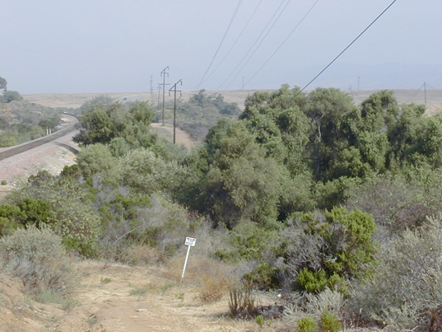
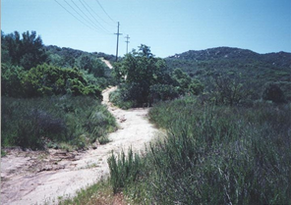
Vegetation Management Components – Records Management
SDG&E Vegetation Management utilizes a computerized work management system to record all vegetation management.
Vegetation Management maintains an inventory of approximately 464,000 trees, which are inspected annually by a contractor force of Certified Arborists.
Any tree identified as a hazard (dead, dying, diseased, leaning, structurally unsound, etc.) is entered into the system during the pre-inspection activity.
After the work is issued to the trim contractor, hazard trees are abated by removing the portion of the crown that could impact the lines or the tree is removed completely.
Each inspection and trim work activity is maintained in the database as a historic record that includes when the work was performed.
Upon completion of the pre-inspection and tree trim/removal activities, an audit is performed by a separate contractor on a representative sample of the work.

Slide 9
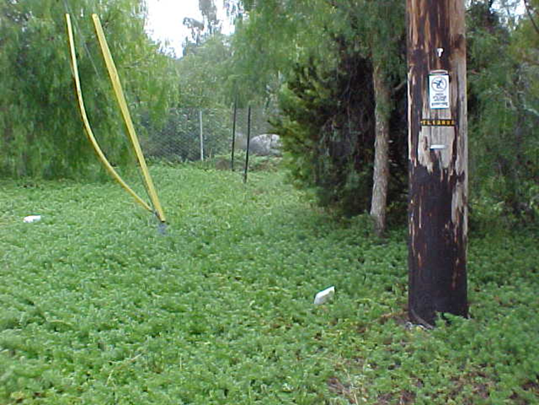
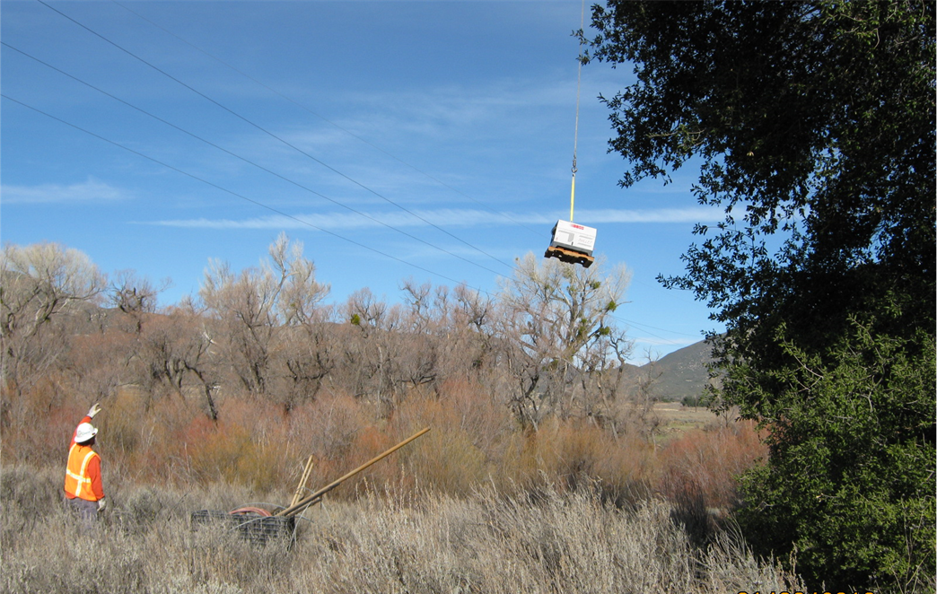
Vegetation Management Components – Customer Refusals
SDG&E Vegetation Management has a specific process to track and record customer refusals.
The process involves multiple communications with the customer, including contact by the tree crew, crew supervisor, and SDG&E Foresters.
If not initially resolved, SDG&E will send the customer a certified letter outlining the applicable safety and compliance issues, and notifying the customer that SDG&E will need to perform the required work.
If the issue cannot be resolved, SDG&E may contact law enforcement to assist with a forced trim.
Vegetation management work is generally completed without substantial delay.

Slide 10
Fire Risk Management (FiRM)
SDG&E is not waiting to improve its electric system to minimize fire risks. Using state of the art modelling, mapping and prioritizing techniques, SDG&E has initiated the Fire Risk Management Project, or FiRM. The FiRM project addresses fire risk by hardening overhead distribution circuits in the Fire Threat Zone (FTZ). The work includes:
Reconductoring
Pole replacements
Undergrounding overhead facilities
Equipment installation or removal
New or upgrading technology
The work is prioritized based on fire risk, values at risk, and public safety. The FiRM Analysis Team is a technical advisory team that also continuously looks at failures in the system and makes project recommendations and new technology recommendations.
7,200 poles located in the High Risk Fire Area (HRFA) were replaced in 2014 and 2015.
Phase 2 of FiRM will address the 30,000 poles between 2015 and 2018.
Phase 3 of FiRM will address the remaining approximately 40,000 poles after 2018.
Cleveland National Forest project would replace 150 miles of wood poles with steel poles as well as undergrounding portions of existing lines and removals from service and reconductoring of certain line segments.

Slide 11
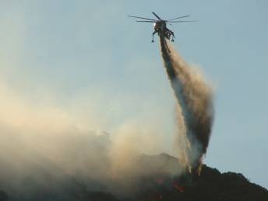
Proactive Operational and Developmental Measures
Turn-off automatic reclosing
Mobilizing crews to pre-determined locations
De-energize for safety when necessary
Staging of washing rigs and fire crews to pre-determined locations
Prior to and throughout the event, SDG&E provides situational awareness and forecasts to CAISO
Coordinate with neighboring utilities for potential support
Take operational actions as needed to optimize power flows in coordination with the CAISO
For major events, the CAISO will declare a system emergency where they may suspend code of conduct and allow out of market sales to stabilize system

Slide 12
Wildfires, Vegetation Management and Powerlines
Thank You
Questions?
David L. Geier
VP – Electric Transmission & System Engineering
San Diego Gas & Electric
DGeier@semprautilities.com

