Slide 1
Ex Parte Requirements at the California Public Utility Commission: A Comparative Analysis and Recommended Changes
Professor Deborah Behles,
Golden Gate University School of Law
Steven Weissman, Lecturer in Residence,
UC Berkeley School of Law

Slide 2
Introduction
“ We think it is a mockery of justice to even suggest that judges or other decision-makers may be properly approached on the merits of a case during [its] pendency. . . .”
Professional Air Traffic Controllers Org v. FLRA, 685 F.2d 547 (D.C. Cir. 1982).

Slide 3
CPUC’s Current Ex Parte Rules
Ex Parte Meetings Broadly Allowed in Contested Proceedings
No Duty for Decision-makers
Rules Not Well-Defined Related to Procedural Matters, Definition of Decision-maker

Slide 4
Major Findings
CPUC’s Ex Parte Practice Is Inconsistent with the Quasi-Judicial Nature of Proceedings.
CPUC’s Ex Parte Approach Is Not Well-suited for a Major Economic Regulatory Agency and an Agency with a High Level of Independence.
CPUC’s Ex Parte Rules Are An Outlier.

Slide 5
Ex Parte Contacts Should Be Prohibited in All Contested Proceedings
Entities that Allow Contacts in Contested Proceedings
CPUC
New York Public Service Commission*
* New York Oversight Commission found that New York’s Rules created a “disparity in the ability of certain classes of utility customers to avail themselves of direct access to decision-makers.”
Entities that Do Not Allow Contacts in Contested Proceedings
FERC
CEC
CARB
Similar State Regulatory Agencies In:
Illinois
Texas
Florida
Nevada
Virginia
Connecticut
Delaware

Slide 6
Decision-Makers Should Have Affirmative Duty To Report Contacts
No Affirmative Duty to Report
CPUC
Not Addressed in Requirements:
Connecticut
New York
Nevada
Virginia
Affirmative Duty to Report
FERC
CEC
CARB
Other Similar State Agencies In:
Texas
Delaware (on website)
Illinois
Florida

Slide 7
Other Recommendations
The Ban Should Expressly Apply to Decision-Makers.
Decision-Makers Should Be Clearly Defined.
All Communications Related to Substance Should Be Covered.
The Distinction Between Procedural and Substantive Issues Should Be Clear.
Procedural Communication Should Only Be Made to the ALJ.

Slide 8
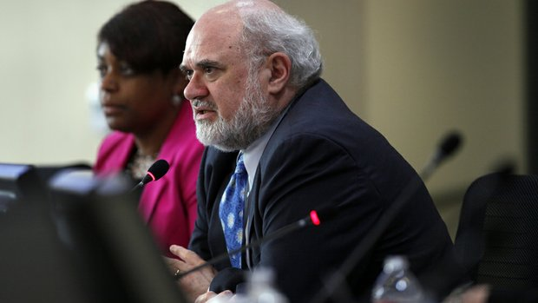
Example of Other Avenues for Public Participation

Slide 9
Next Steps and Questions

