Slide 1

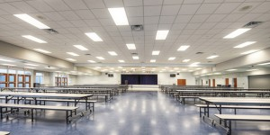
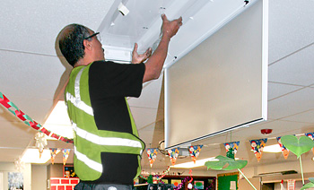
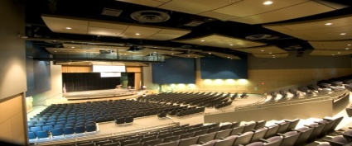
CALIFORNIA CLEAN ENERGY JOBS ACT
LAUSD PROPOSITION 39
ENERGY EFFICIENCY PROGRAM
Presentation 01/20/16

Slide 2

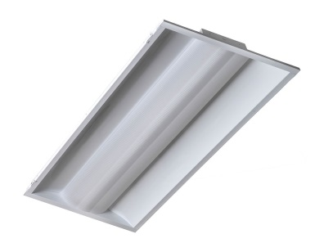

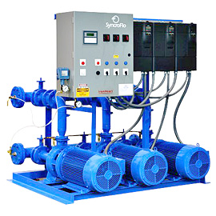
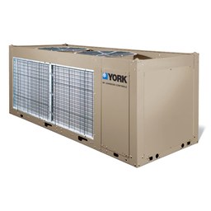
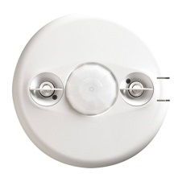
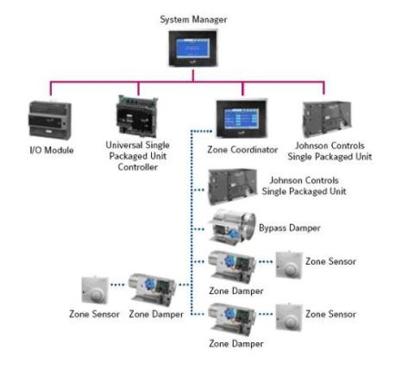
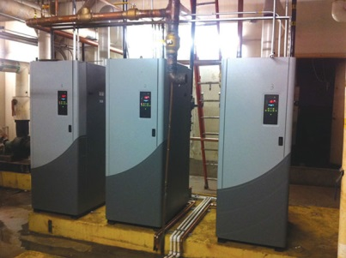
LAUSD Maintenance & Operations – Sustainability Initiatives Unit
Proposition 39 Energy Efficiency Program
PROJECT TYPES
District focus is on Energy Efficiency and Retro-Commissioning projects that reduce energy use in existing building systems.
Lighting
Interior fixture - Retrofit or Replacement, w/ Dimmable Ballasts
HVAC
Air Handler & Package Units - Repair, Modify or Replace
Plumbing
Domestic Water Heaters - Repair, Modify or Replace
Exterior fixture - Retrofit or Replacement
Adjust temperature set points
Consider Condensing or Tankless Water Heaters
Controls
Energy Management Systems - HVAC
Rewire interior lights for Daylight control and dimming
Chiller control upgrades
Lighting controls – interior & exterior lighting
Pumps, Economizers and VFDs - Repair, Replace or New
Adjust temperature set points
Occupancy & Daylight sensor – Repair, Replace or New
Revise equipment operating schedules

Slide 3
LAUSD Maintenance & Operations – Sustainability Initiatives Unit
Proposition 39 Energy Efficiency Program
Flow Chart & Selection Criteria

Slide 4
LAUSD Maintenance & Operations – Sustainability Initiatives Unit
Proposition 39 Energy Efficiency Program

Slide 5
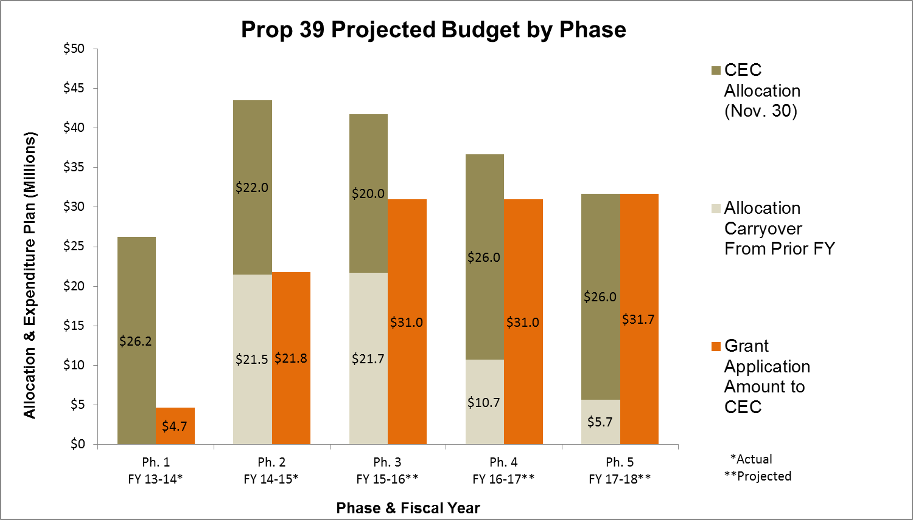
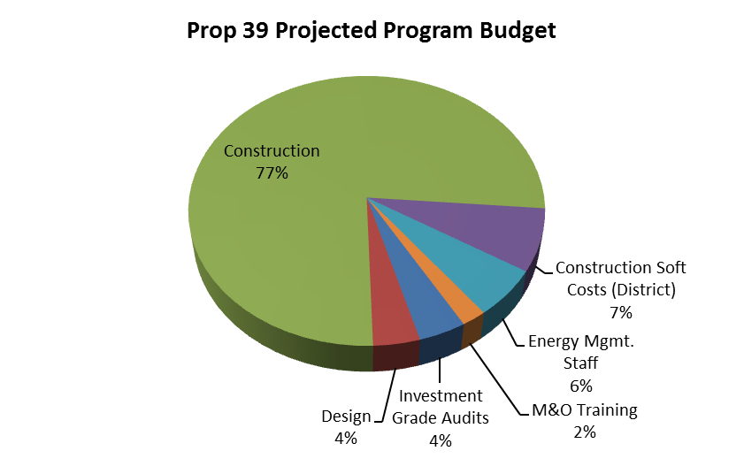
LAUSD Maintenance & Operations – Sustainability Initiatives Unit
Proposition 39 Energy Efficiency Program
Note 1: Not including Affiliated Charter Schools (estimated @ $15M over 5 years)

Slide 6
LAUSD Maintenance & Operations – Sustainability Initiatives Unit
Proposition 39 Energy Efficiency Program

Slide 7
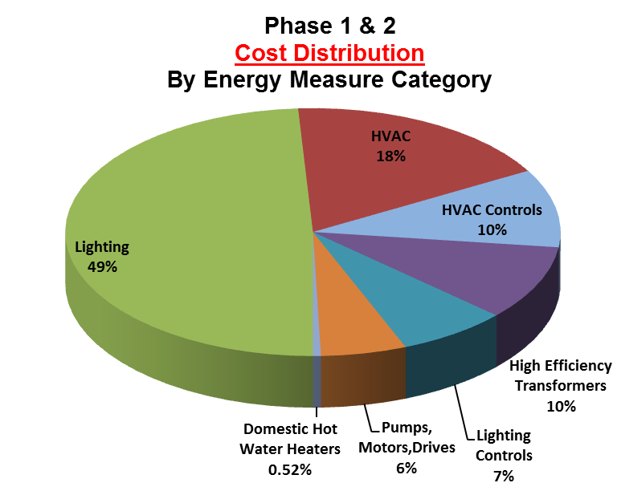
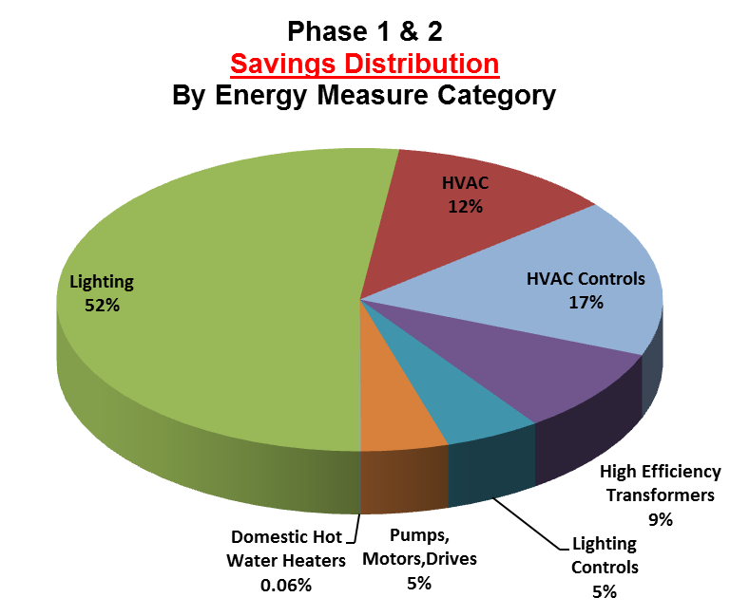
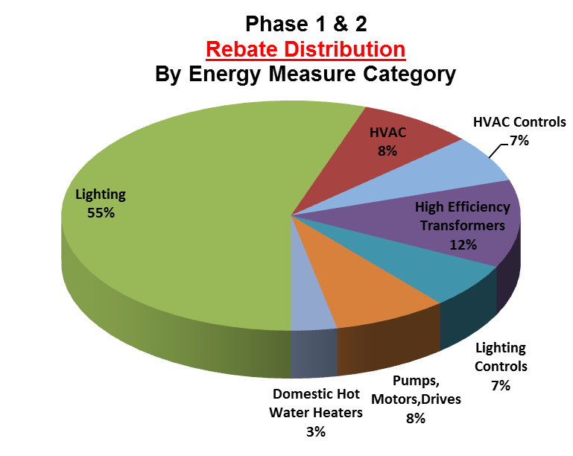
LAUSD Maintenance & Operations – Sustainability Initiatives Unit
Proposition 39 Energy Efficiency Program

Slide 8
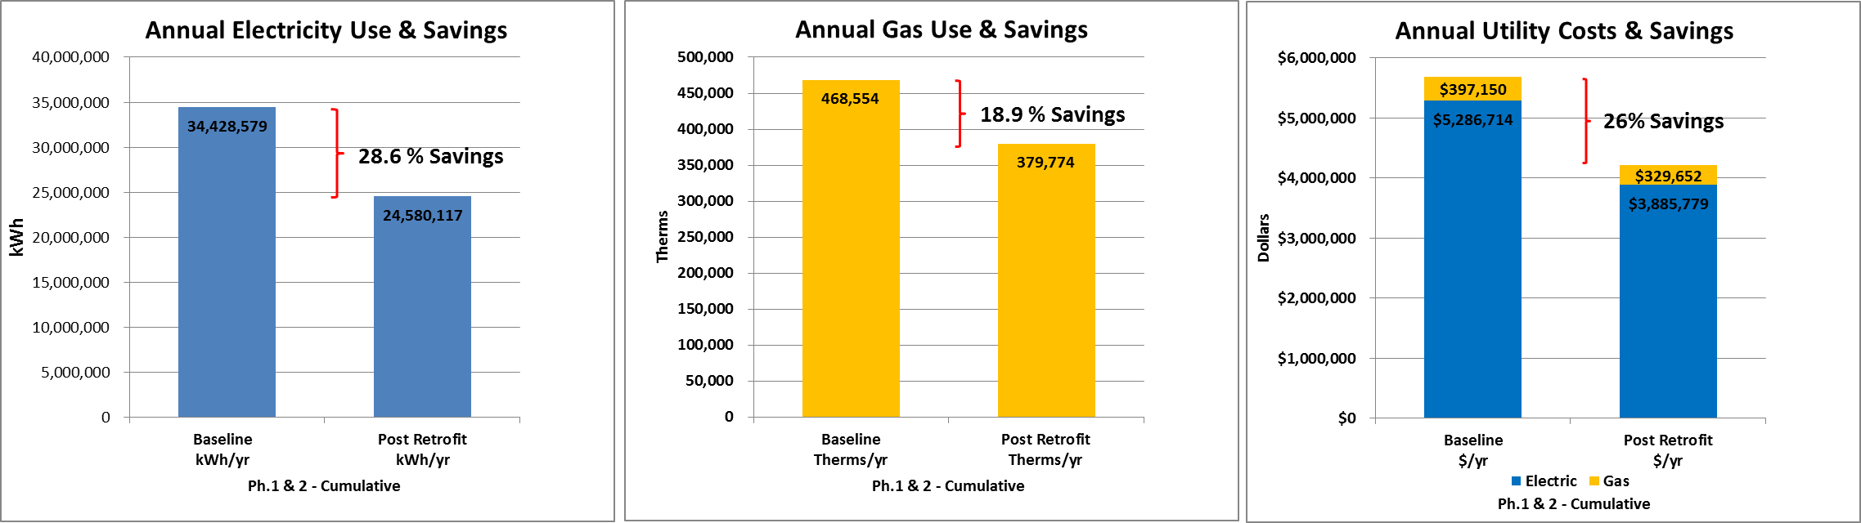
LAUSD Maintenance & Operations – Sustainability Initiatives Unit
Proposition 39 Energy Efficiency Program

Slide 9
LAUSD Maintenance & Operations – Sustainability Initiatives Unit
Proposition 39 Energy Efficiency Program
LESSONS LEARNED / CHALLENGES
Contractor Resources and School Coordination
Understand site coordination & logistics issues.
Develop phasing plan & appropriate working hours to accommodate school schedule.
Streamline Utility Rebate Process
Prevent Delays in Application Review and Scheduling Pre-Inspection.
Require Energy Service Companies to attend all Rebate Program training seminars sponsored by the Utility.
Agency Collaboration with Department of State Architecture (DSA)
Determining Type of Projects that Require DSA Approval.
Streamlining Submittal and Approval Process.
Streamline District’s Process to Review and Approve New Technologies
LED Lighting, Wireless Controls, Tankless Domestic Water Heaters.
New Title 24 Requirements
Incorporation of new Title 24 energy requirements for lighting and mechanical systems.
Lighting control requirements such as daylight harvesting sensors which has high installation costs and low energy savings will adversely affect the SIR and the number of energy measures that can be implemented.

Slide 10
LAUSD Maintenance & Operations – Sustainability Initiatives Unit
Proposition 39 Energy Efficiency Program
OVERALL PROGRAM IMPACTS (Phases 1-5)
Jobs Creation
550 Job Years (As estimated through the CEC Calculator).
General Fund Savings
$5.84 Million estimated in Annual Electric & Gas Savings.
Improve Learning Environment
Improved Lighting & Temperature Control in Classrooms.
Lower Maintenance Costs
New LED lighting with less replacement costs.
Retrofitted and Retro-commissioned HVAC Systems to meet current requirements.
Energy Management Systems to improve HVAC controls and operating schedules.
Student Energy Auditor Training
60-80 High School Seniors trained in performing energy surveys.
Partner with the California Conservation Corps & Los Angeles Conservation Corps.

