Slide 1
California Conservation Corps
Energy Corps Program
– Proposition 39 –
Energy Corps
Contact: Bill McNamara
Bill.McNamara@ccc.ca.gov
20 January 2016 - California Conservation Corps

Slide 2
Energy Corps Program
- CCC Energy Corps -
Energy Corps
Founded by Governor Brown in 1976, the CCC and its Corpsmembers have more than 30 years of successful engagement in Energy Efficiency (EE) and Renewable Energy (RE) projects and programs throughout California. In 2013 the CCC established the “Energy Corps” as an operational group within the CCC that provides:
Energy Industry Training & Work Experience – CCC Corpsmembers and
Staff are professionally trained to become highly capable, efficient and cost effective
resources for a variety of EE and RE projects and programs.
Cooperative Energy Industry Partnerships – EE & RE project and program
opportunities that provide energy industry training & work experience for
Corpsmembers are developed between energy industry experts (Energy Corps
‘partners’), Sponsors/Recipients of Services, and the CCC.
Innovative Program Designs - Working with Energy Corps partners to create
new EE and RE Programs and Projects that engage Corpsmembers.
Energy Industry Services - Provided to California LEAs, energy industry
companies, utilities, State and Local Government Agencies, non-profit organizations,
and others.
20 January 2016 - California Conservation Corps

Slide 3
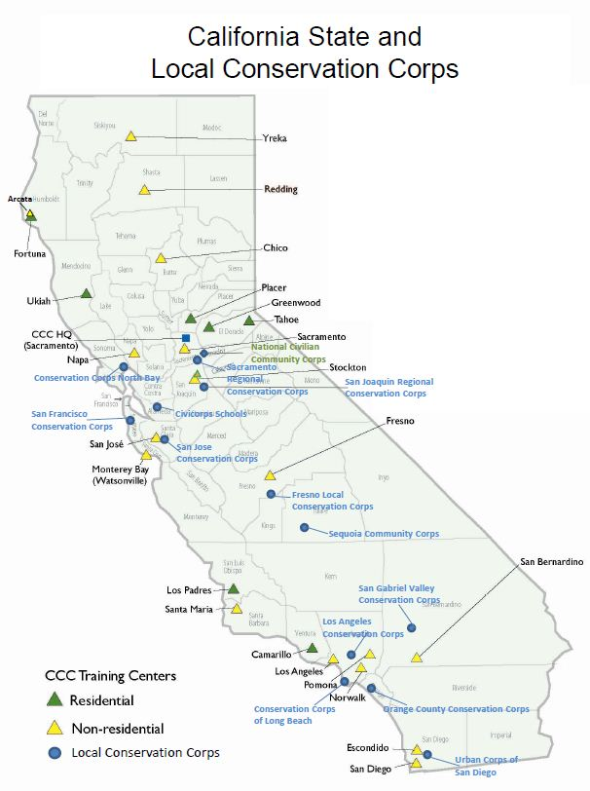
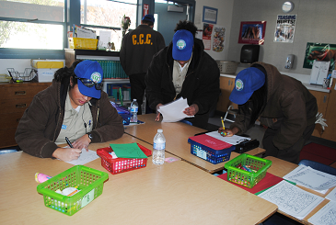
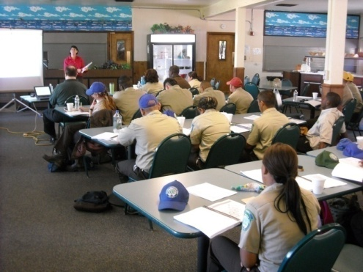
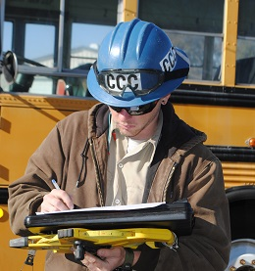
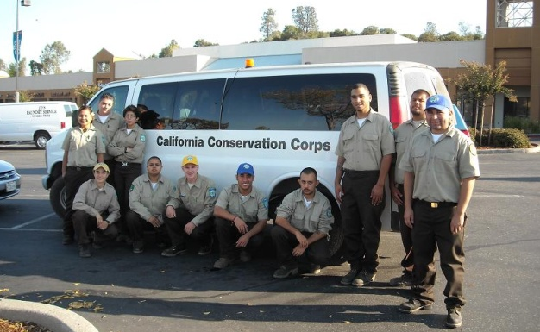
Energy Corps Program
- CCC Resources and Infrastructure -
Energy Corps
With 26 CCC operating centers and 14 Local Conservation Corps located throughout California, the CCC and participating certified local Conservation Corps can provide extensive professionally trained and managed Corpsmembers, infrastructure, and a range of services for Energy Efficiency & Renewable Energy Projects & Programs.
CCC & Local Corps
CCC Energy Corps Crew Locations
20 January 2016 - California Conservation Corps

Slide 4
Energy Corps Program
- Proposition 39 Goals -
Energy Corps
The CCC’s Energy Corps Program is designed to meet the following goals:
Provide Extensive Energy Industry Training and Work Experience
Energy Industry Training - Extensive energy industry training experience for
Corpsmembers (young adults from 18 to 25, and recently returned veterans up to 29).
Energy Industry Work Experience - Helping to develop the ‘next generation’ of energy
industry workers through extensive energy industry work experience and a continuum of
on-the-job training and education.
Create Energy Job Opportunity Pathways - Creating partnerships with energy
industry companies that develop into employment opportunity ‘pathways’ for
Corpsmembers interested in pursuing careers in the energy industry.
Save Energy and Reduce Operating Costs for LEAs
Energy Opportunity Surveys - Conduct thousands of energy industry standard ASHRAE
compliant ‘no cost’ and ‘low cost’ whole building Energy Opportunity Surveys (energy
audits) for LEAs (providing LEAs with on sight collection of all energy systems and energy
use data, detailed energy use and physical inventory site information necessary to identify,
calculate, and recommend available energy savings opportunities).
Retrofit Installation - Perform ‘low cost’ Energy Efficiency Retrofit installations that
generate substantial (and sustainable) energy & cost savings for LEAs.
“Best Practices” - Provide LEA facility management and staff with detailed Operations
and Maintenance (O&M) whole building ‘Best Practices’ for energy efficiency.
20 January 2016 - California Conservation Corps

Slide 5
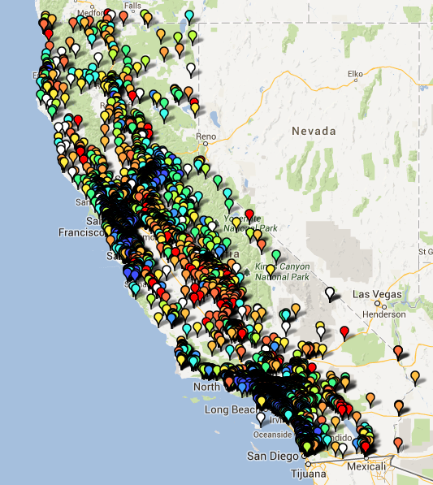
- Proposition 39 Funded Services For LEAs -
Distribution of 1,979 California LEAs
Energy Corps Program
Energy Corps Program
Prop 39 Funding
Annual Allocation
$5.0 Million
$
CCC Providing
‘No Cost’ & ‘Low Cost’ EE & RE Services
Statewide For LEAs
$
Prop 39 Funding
LEA Submits EEP to
CEC For Approval -
CDE Allocates
Funds to LEA
Corpsmembers
LEAs
* ‘No Cost’ Energy Opportunity Surveys
* ‘Low Cost’ Energy Opportunity Surveys
* ‘Low Cost’ EE Retrofit Projects
* ‘No Cost' EE Presentations
$$$
20 January 2016 - California Conservation Corps

Slide 6
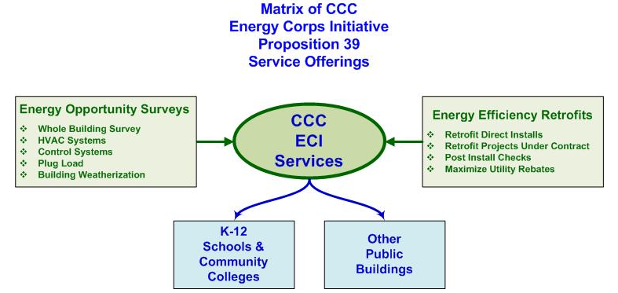
Energy Corps Program
- Proposition 39 Funded Service Offerings -
Energy Corps
‘No Cost’
& ‘Low Cost’
Energy Opportunity Surveys For LEAs
‘Low Cost’
Retrofit Projects
(Materials & Related Costs Only) For LEAs
1
2
4 CCC EO Survey Crews & 6 EE Retrofit Crews Operate Statewide from 8 Locations
‘No Cost’ & ‘Low Cost’ Energy Efficiency
Classroom Presentations, Cooperative Education & Other Educational Opportunities
Provided For LEAs
LEAs
K-12 Schools
3
CCC EO Survey Crew Locations
20 January 2016 - California Conservation Corps

Slide 7
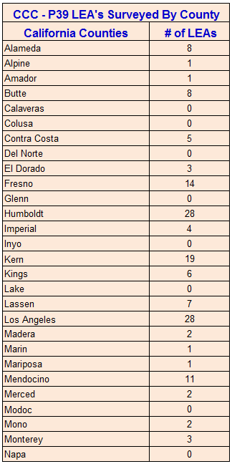
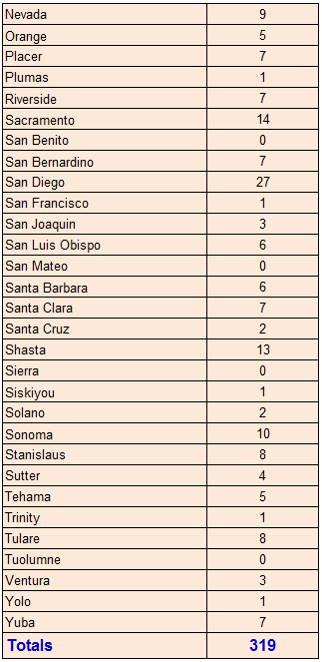
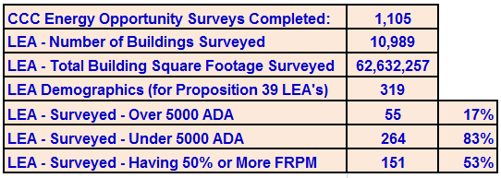
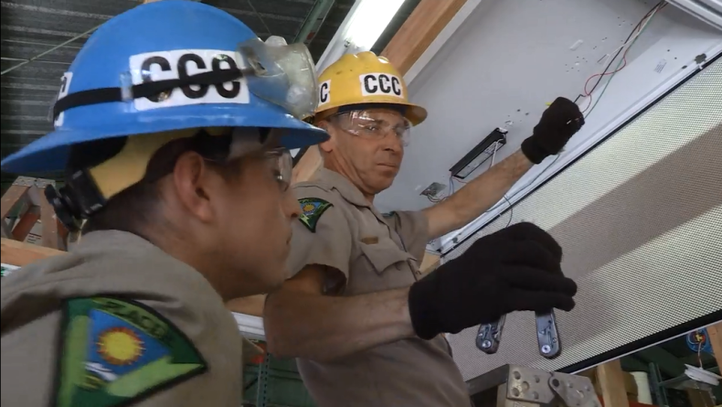
Energy Corps Program
- Proposition 39 Funded Program Status -
Energy Corps
Status - Surveys: In January of 2014, the CCC’s ‘Energy Corps’ deployed 10 Proposition 39 Funded Crews of trained and supervised Energy Corps Corpsmembers to provide ASHRAE compliant ‘Whole Building’ Energy Opportunity Surveys (energy audits) for Local Educational Agencies (LEAs). In mid 2015 the Energy Corps began providing Proposition 39 funded EE Lighting Retrofit Installation services for LEAs throughout the State. The status of Proposition 39 funded Energy Opportunity Survey services provided to date by the CCC is as follows:
20 January 2016 - California Conservation Corps

Slide 8
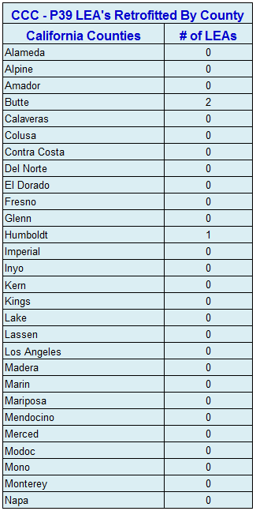
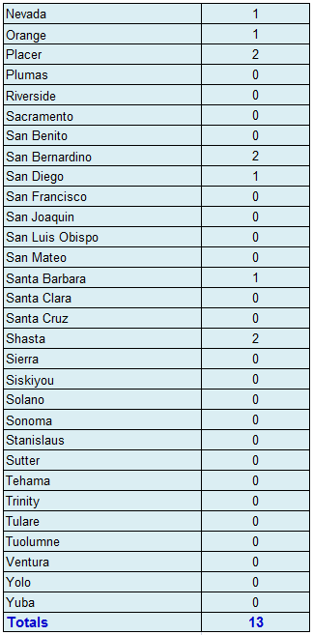
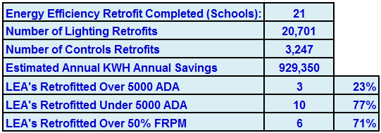
Energy Corps Program
- Proposition 39 Funded Program Status -
Energy Corps
Status - Retrofits: In January of 2014, the CCC’s ‘Energy Corps’ deployed 10 Proposition 39 Funded Crews of trained and supervised Energy Corps Corpsmembers to provide ASHRAE compliant ‘Whole Building’ Energy Opportunity Surveys (energy audits) for Local Educational Agencies (LEAs). In mid 2015 the Energy Corps began providing Proposition 39 funded EE Lighting Retrofit Installation services for LEAs throughout the State. The status of Proposition 39 funded EE Retrofit Installation services provided to date by the CCC is as follows:
20 January 2016 - California Conservation Corps

Slide 9
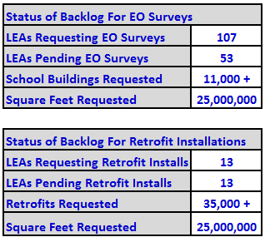
Energy Corps Program
- Proposition 39 Funded Program Status -
Energy Corps
Status - Backlog of Survey Requests: The current mix of Proposition 39 Funded CCC Energy Corps Crews is: 6 Retrofit and 4 Energy Opportunity Surveys. Due to the very large volume of Schools that LEAs requested for Energy Opportunity Surveys during the first year of Proposition 39 funded services, the CCC stopped accepting applications from LEAs for Energy Opportunity Surveys in July of 2014. The current backlog of requests for Surveys represents
approximately 2.5 years of work for 4 CCC Energy Corps Surveys Crews operating on a full time basis.
Status - Backlog of Retrofit Installation Requests: Retrofit installation projects require more time to complete. The CCC Energy Corps began offering LEAs Retrofit Installation services in mid 2015. Requests for these CCC Energy Corps Retrofit Services is increasing very rapidly as more LEAs become aware of their availability.
20 January 2016 - California Conservation Corps

Slide 10
Energy Corps Program
- Proposition 39 Funded Program Status -
Energy Corps
Status - Training: In January of 2014, the CCC’s ‘Energy Corps’ deployed 10 Proposition 39 Funded Crews of trained and supervised Energy Corps Corpsmembers to provide ASHRAE compliant ‘Whole Building’ Energy Opportunity Surveys (energy audits) for Local Educational Agencies (LEAs). In mid 2015 the Energy Corps began providing Proposition 39 funded EE Lighting Retrofit Installation services for LEAs throughout the State. The following is the status of Proposition 39 funded Training provided to date:
Corpsmembers trained (Energy Opportunity Surveys) 439
Corpsmembers trained (OSHA 10./30) 154
Corpsmembers trained (Lighting Retrofit Installations) 174
Corpsmembers trained (On-Line Energy University) 212
Corpsmembers trained (EE Presentations) 93
CCC Staff trained 33
CCC Total training hours 43,000 +
20 January 2016 - California Conservation Corps

Slide 11
Energy Corps Program
- Proposition 39 Funded Program Status -
Energy Corps
Status - Corpsmembers Hired: In January of 2014, the CCC’s ‘Energy Corps’ deployed 10 Proposition 39 Funded Crews of trained and supervised Energy Corps Corpsmembers to provide ASHRAE compliant ‘Whole Building’ Energy Opportunity Surveys (energy audits) for Local Educational Agencies (LEAs). In mid 2015 the Energy Corps began providing Proposition 39 funded EE Lighting Retrofit Installation services for LEAs throughout the State. The following is the status of Hires and Requests to Hire CCC Energy Corps Corpsmembers resulting from their Proposition 39 funded training and work projects to date:
Corpsmembers Hired by Energy Industry Companies 25
Requests from multiple Energy Industry Companies for
Energy Corps Corpsmembers to Hire (# CMs requested) 120+
Status - Requests to Hire Corpsmembers: Many energy industry companies have begun to regard the CCC’s Energy Corps as a very good source for hiring entry level employees. Companies who initially approach the CCC seeking Energy Corps partnering opportunities have often requested to hire Energy Corps Corpsmembers. The demand received by the CCC in 2015 for trained and experienced Energy Corps Corpsmembers was much greater than could be supplied (in terms of sufficiently trained Corpsmembers with Energy Corps work experience). Individual Energy Industry Companies have requested up to 50 Corpsmembers for immediate hire, and as a collective, they have requested more than 120 Corpsmembers for hire. The CCC’s Energy Corps has achieved this positive reputation as a source for entry level energy industry new hires through providing a high standard of training and demonstrated work ethics and skills while performing these Proposition 39 Funded energy efficiency ‘work-learn’ projects for LEAs.
20 January 2016 - California Conservation Corps

Slide 12
Energy Corps Program
- Proposition 39 Funded Services -
Energy Corps
For more information about the CCC’s Energy Corps, please visit the CCC Website: http://www.ccc.ca.gov/work/programs/prop39/Pages/default.aspx
20 January 2016 - California Conservation Corps

