Slide 1
Macroeconomic Impacts
Change from Baseline trend in 2030. Billions of 2012 dollars and FTE jobs.
Dr. David Roland-Holst, Plug-in Electric Vehicle Deployment in California: An Economic Assessment, September 2012

Slide 2
Why it works
The carbon fuel supply chain is among the least job-intensive in the economy.
Expenditure Shifting
Source: California Dept of Finance and Employment Development Office

Slide 3
Carbon reduction opportunities for meeting the Low Carbon Fuel Standard
Numerous studies conducted by clean fuel industries, business organizations, and environmental groups

Slide 4
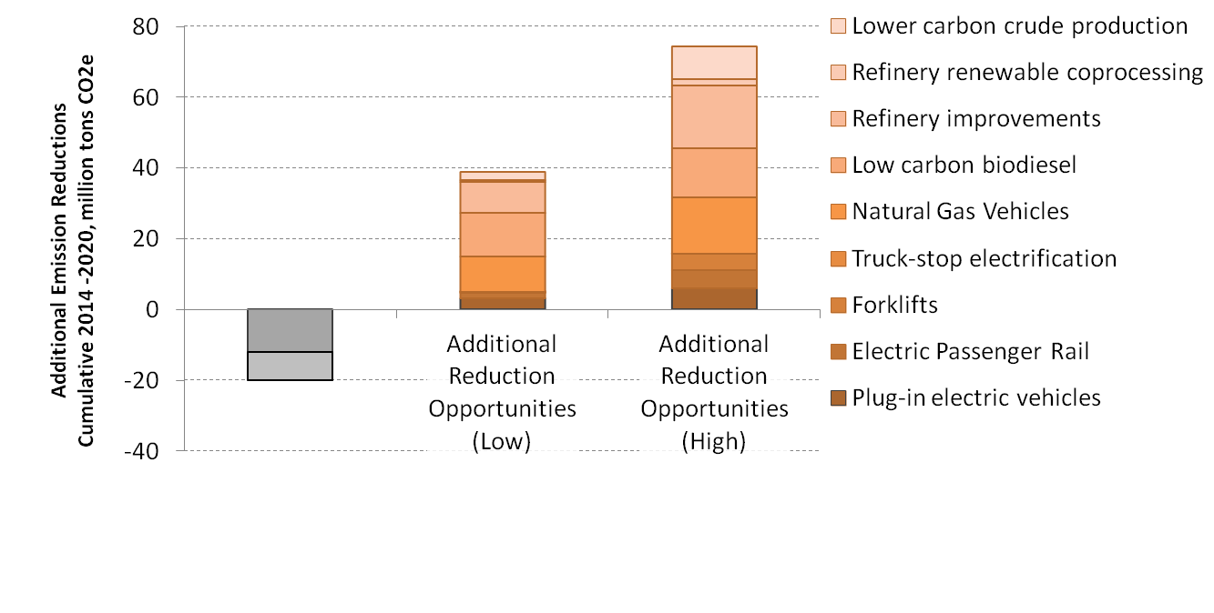
Reduction Opportunities: How to overcome a shortfall scenario
Low
High
WSPA Shortfall Scenario

