Slide 1
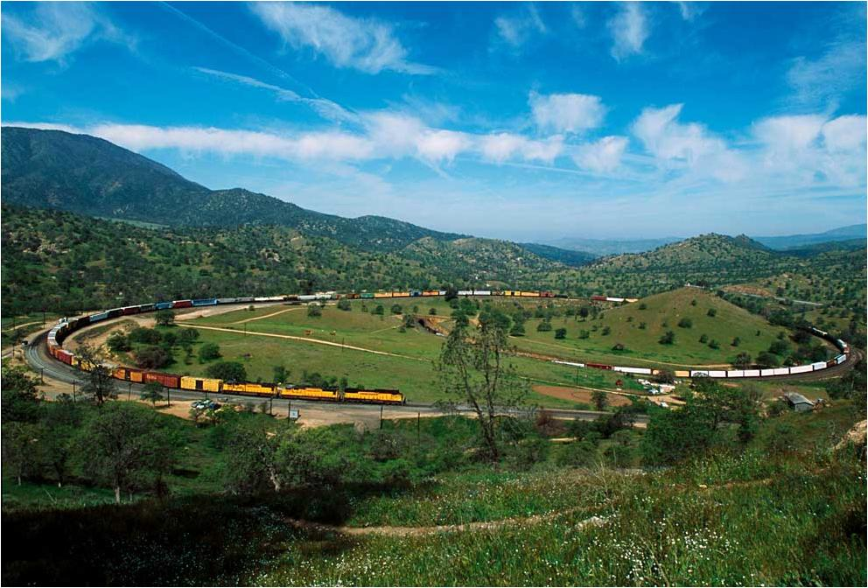
Union Pacific Railroad
David Wickersham
Chief Engineer, Western Region
February 24, 2014

Slide 2
Key Union Pacific Railroad Corridors
Fast Facts
Route miles 32,000
      in 23 states
Employees 46,000
Annual Payroll $4.3B
Customers 10,000
Locomotives 8,400
Seattle
Eastport
Eastport
Portland
Duluth
Duluth
Powder River Basin
Twin Cities
Twin Cities
I-5
Central Corridor
Chicago
Omaha
SLC
Omaha
Denver
Denver
N. Platte
KC
Oakland
St. Louis
West Colton
Memphis
LA
West Colton
LA
Phoenix
Calexico
El Paso
Ft. Worth
Dallas
Shreveport
Key Entry from Asia
Nogales
Sunset Route
San Antonio
New
Orleans
Eagle Pass
Houston
Laredo
Brownsville
Notes:
Corridors
Strategic Markets
Key Franchises
Competitive Advantages
Growth Opportunities
Corridor Principles
Design for Throughput, Productivity, & Performance
Network Access
Reliability
Recoverability
Balanced Investment

Slide 3
UPRR – Routes in California
2012 Fast Facts
Miles of Track 3,283
Annual Payroll $430.7 M
In-State Purchases $233.3 M
Capital Spending $376.1 M
Employees 4,872
Community Giving $1.4 M
Charitable Organizations 385
I - 5 Route
Feather River Route
Donner Pass Route
San Joaquin Valley Line
Coast Line
Sunset Route

Slide 4
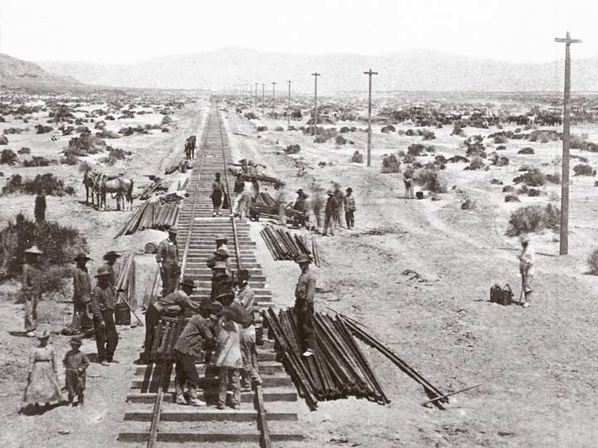
How We Built Track Over 150 Years Ago

Slide 5
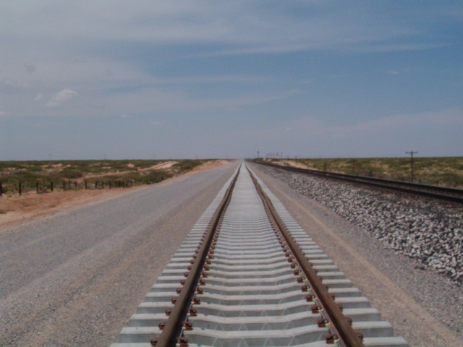
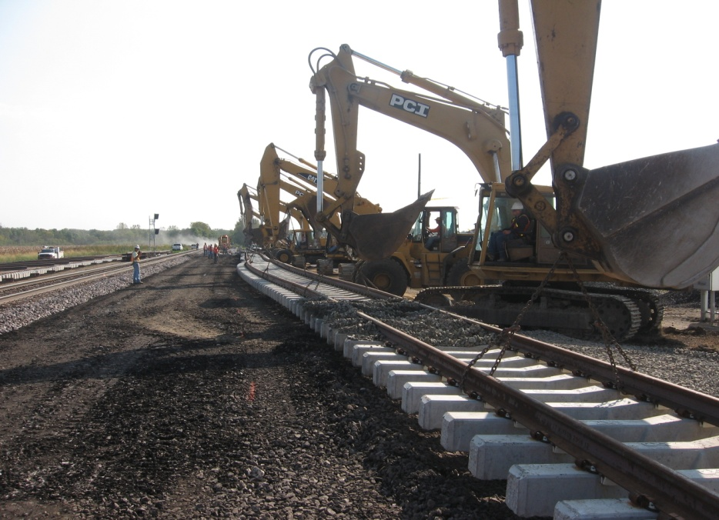
Today’s Track Design & Construction
Foundation
Drainage
Concrete ties
Continuous welded rail
Notes:
.

Slide 6
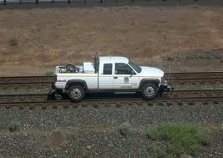
UPRR Track Inspection Program
43 – Full time dedicated track inspectors working within California
  Training – 5 day FRA track safety standards
  Monthly evaluations by managers
  Annual training and on the job training - track maintenance field handbook
17 – Managers of Track Maintenance in California
480 – track maintenance employees in California
Tracks inspected with “hy-rail” pickups more than twice per week
Visual inspections prevent derailments
  Broken rails
  Track surface conditions
We perform special inspections
  During storms
  After earthquakes

Slide 7
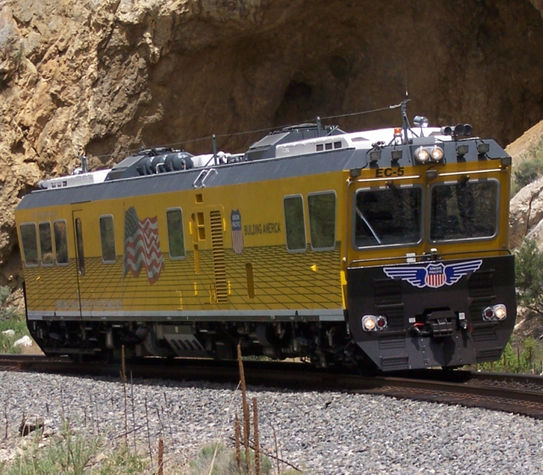
UPRR Track Evaluation System
2 state of the art track geometry cars - $10 million a piece
Prevents track geometry related derailments
Test main lines in California at least twice per year.
Measures track geometry parameters – FRA standards and UPRR policies
  Track Gage
  Track Cross level
  Track profile
  Track Alignment
Also provides
  Rail Profile measurements – curve wear
  Clearances in tunnels and bridges
  Video of track

Slide 8
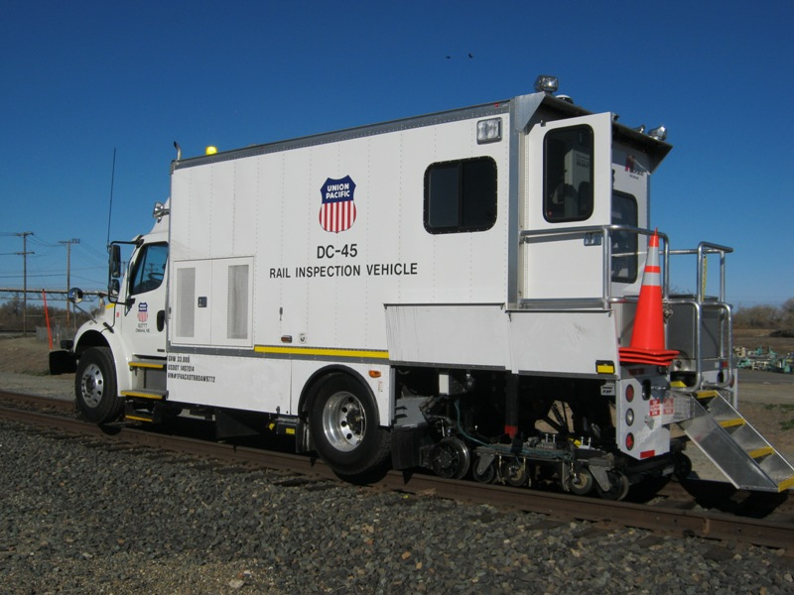
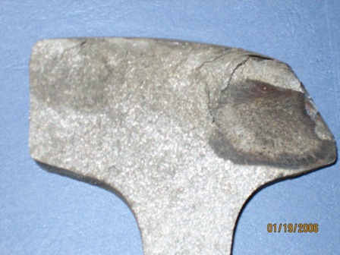
UPRR Rail Detector System
Key technology to prevent broken rail derailments
UPRR tests main line rail in California every 3 to 6 months
  Test frequency is based on tonnage
  Test frequency is more than FRA requirement
We dedicate 4 rail detectors full time in California
Ultrasonic (sound wave) searches internally for rail flows
Cars in California are the latest technology
    2 years old or less
Car averages 7 mph.

Slide 9
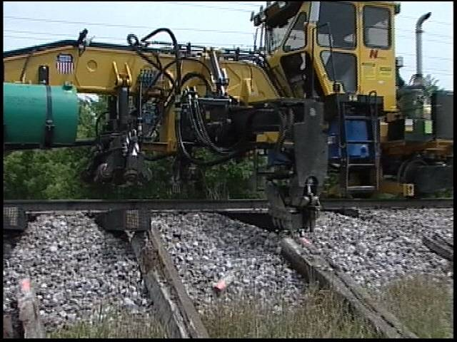
UPRR – Capital Track Maintenance projects in California
Last 5 years, UP has replaced 2,054,000 ties and 452 miles of rail in California.
$992 million
Replacing ties and rail
  2009 542,000 ties, 89 miles new rail
  2010 174,000 ties, 41 miles new rail
  2011 325,000 ties, 65 miles new rail
  2012 446,000 ties, 136 miles new rail
  2013 567,000 ties, 121 miles new rail

Slide 10
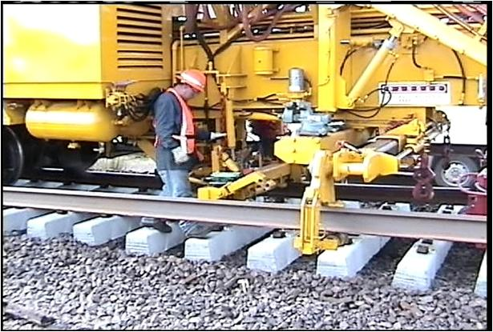
Track Upgrades
UP’s plan to replace wood tie track with concrete tie track
  Tehachapi mountains – complete
  Dunsmuir – complete
  Feather River Canyon – complete
  Sunset Route – 50% complete
  Donner Pass – 33% complete

Slide 11
UPRR Bridge Management Program
System Bridge Statistics
Key Statistics for Union Pacific System California
Total Number of Bridge Structures 19,339 3099
Total length of Bridge in Miles 407 56
Miles of Concrete Bridge 138 20
Miles of Steel Bridge 183 26
Miles of Timber Bridge 86 10
Number of Culverts 52,846 7340
Total Length of Tunnels in Miles 62 28

Slide 12
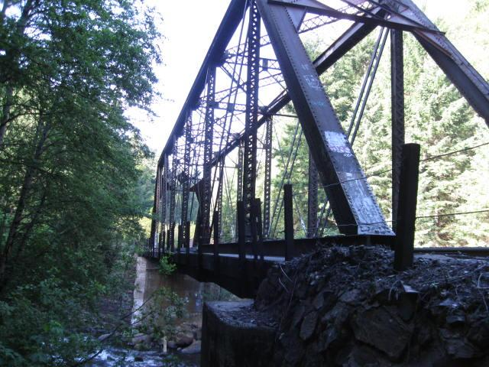
UPRR Bridge Inspection Program
Ensure structural integrity of bridges, culverts, and tunnels.
Comply with FRA CFR 49 Part 237 Bridge Safety Standards
All bridges are inspected between 1 and 3 times per year

Slide 13
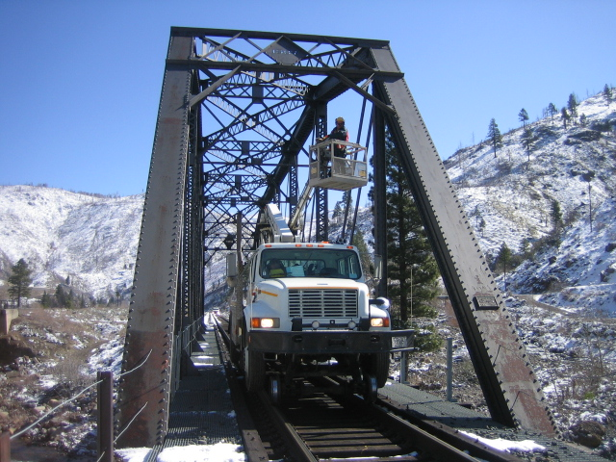
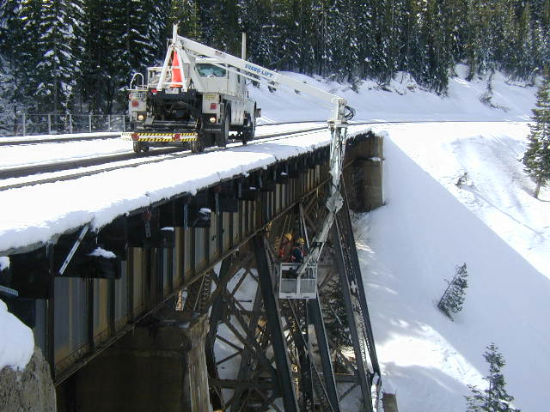
UPRR Bridge Inspection Program
Structures Assessment Team
6 – 2 person - full time teams working within California
1 snooper truck (hyrail access truck) on Western Region
66 bridge maintenance employees in California
2 Managers of Bridge Maintenance in California
1 Director of Bridge Maintenance in California
All report to Assistant Chief Engineer Structures

Slide 14
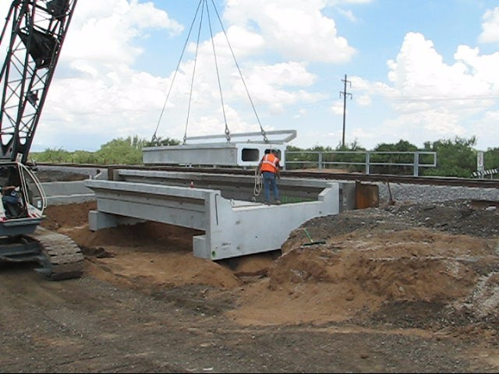
UPRR – Bridge replacement projects in California
Last 5 years, UP has upgraded 70 bridges
$70.2 million
Replacing timber with steel and concrete
  2009 12 bridges, 2,288 feet
  2010 25 bridges, 980 feet
  2011 14 bridges, 242 feet
  2012 9 bridges, 760 feet
  2013 10 bridges, 2,020 feet

Slide 15
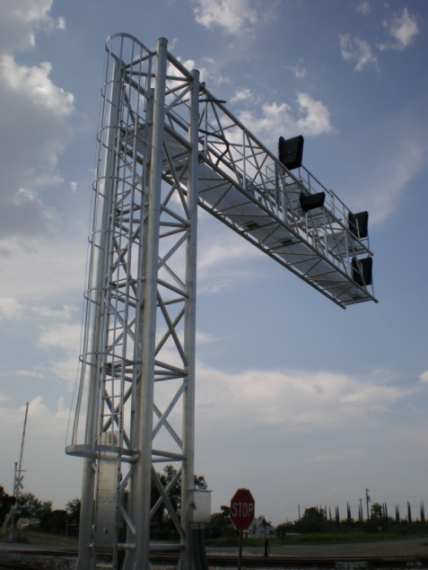
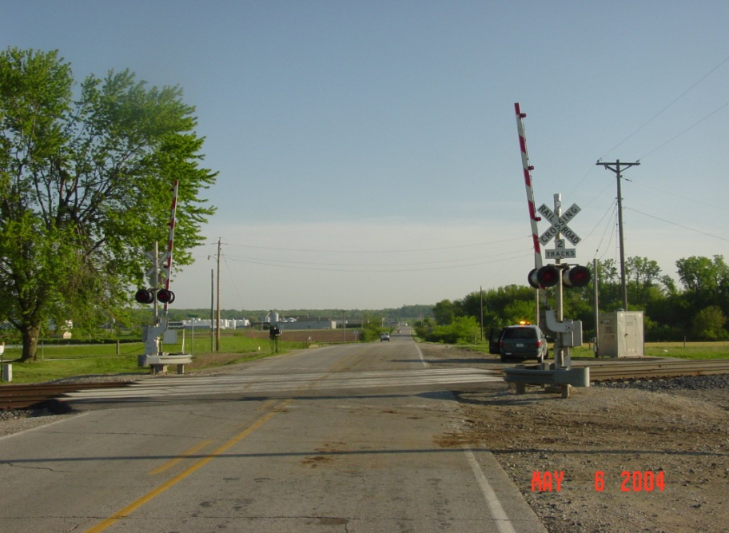
UPRR Signal Inspection Program
218 – Signal Maintenance employees in California
  10 Managers of Signal Maintenance
  23 Signal maintenance foreman
  4 Signal inspectors
  20 Electronic technicians
  161 Signal Maintainers (50% of time spent testing)
  16 Electricians
What they do
  Maintain the wayside signal system
  Maintain and inspect crossing gates
Signal System
  Governs movement of trains
  Provides broken rail protection

Slide 16
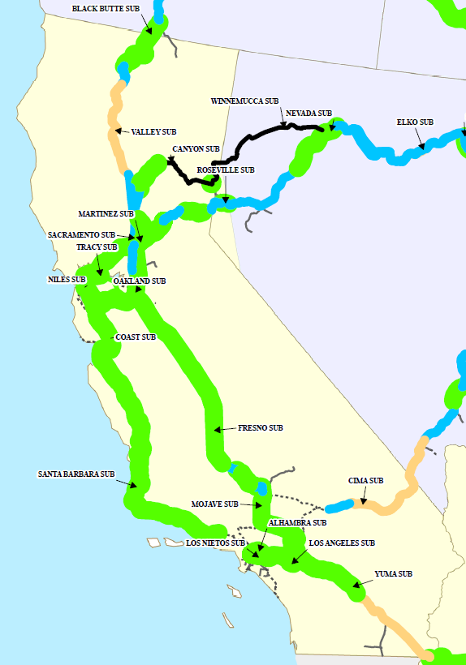
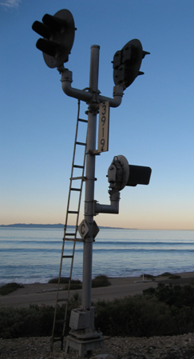
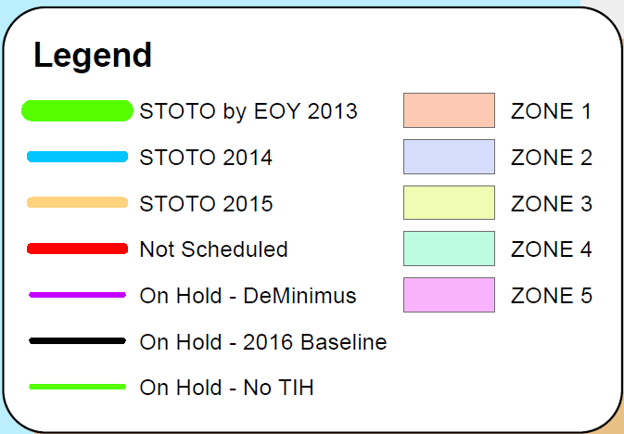
Positive Train Control (PTC) – Signal Construction

Slide 17
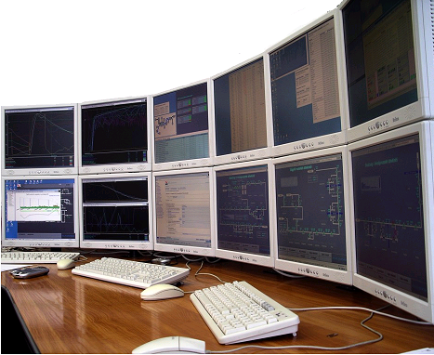
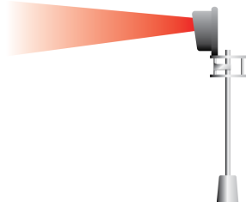
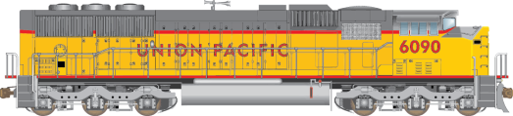
PTC – System Overview
Dispatch,
MIS and
Crew Systems
PTC Back
Office Server
Track Topology
RSIA Mandate – 10/16/08
• PTC will prevent
Train to train collisions
Over-speed derailments
Unauthorized entry into work zone
Switch misalignment
• Must be interoperable
PTC implementation by 12/31/15
• Regulations issued 1/15/10
Temporary Speed Restrictions
Work Zones
Train Consist
Movement Authorities
BRAKING IN PROGRESS
WARNING BRAKING IN 70 SEC
Initialization
Warning Curve
Braking Curve
Predictive Braking

Slide 18
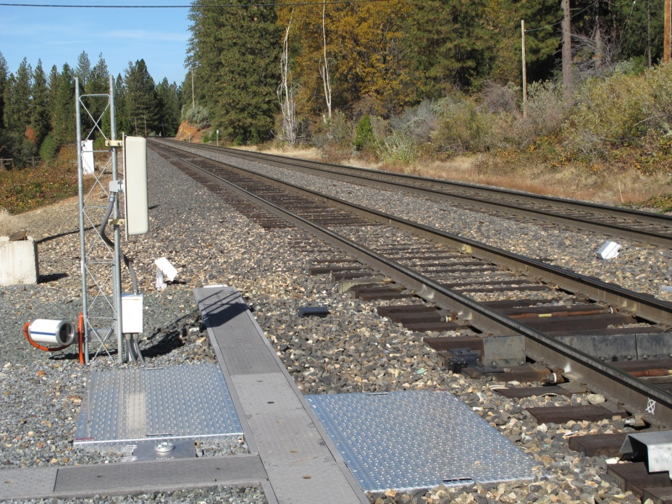
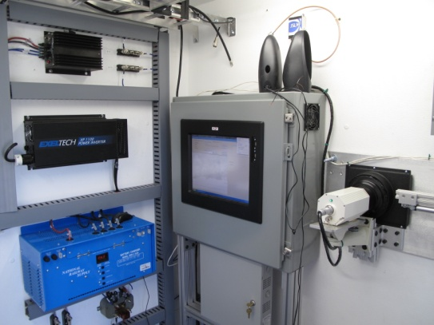
UPRR Wayside Detection System
Wayside detectors prevent railcar caused derailments
  Bearing temperature scanners (1,504 on our system)
  Wheel temperature scanners (236)
  Dragging equipment detectors (2,837)
  High/Wide shifted load detectors (106)
  Wheel Impact detectors (17)
  Acoustic bearing detectors ((7)
  Low Hose detectors (6)
  Wheel profile measuring systems (4)
  Sliding wheel detectors

