Slide 1


Adjusting to a Post-NAFTA Mexico: What It Means for California
J. Edward Taylor and Diane Charlton
Department of Agricultural & Resource Economics
UC Davis
Legislative Hearing on “NAFTA: Challenges and Opportunities after 20 Years,” Senate Select Committee on California-Mexico Cooperation, State Capitol Building
May 5, 2014

Slide 2
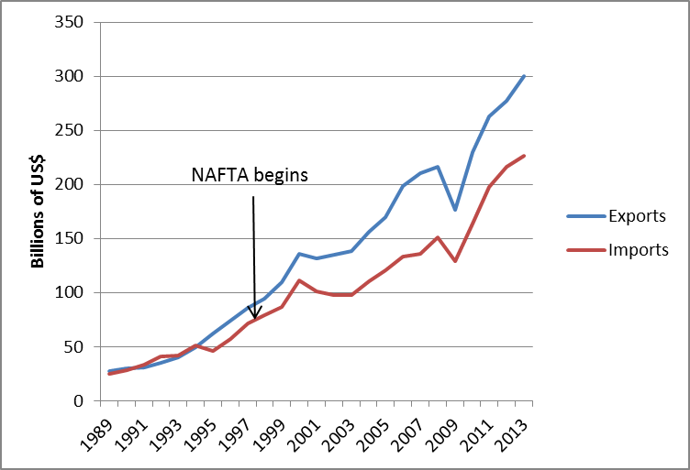
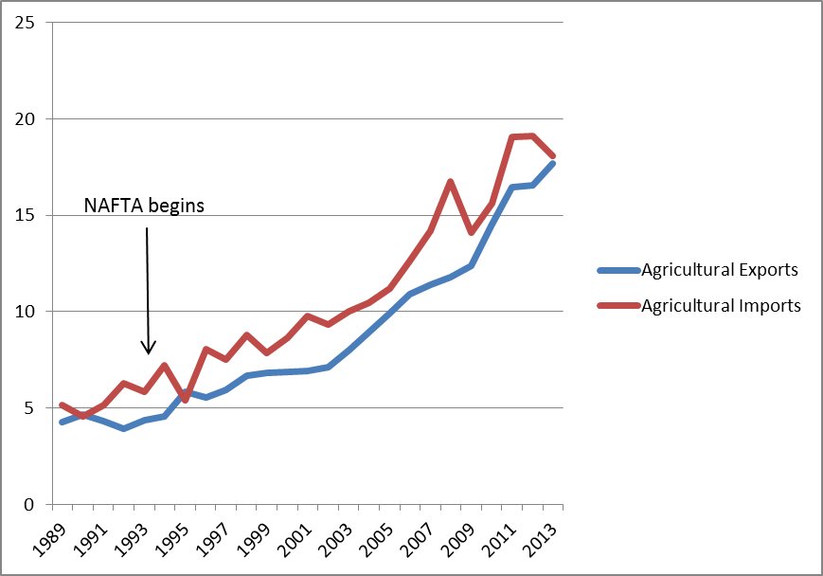
US-Mexico Trade Expanded Sharply After NAFTA
Total
Agricultural
In NAFTA’s first 20 years (1993-2012), US exports to Mexico rose 420%, while Mexico’s exports to the US jumped 596%
US agricultural exports to Mexico rose 311%, while Mexico’s agricultural exports to the US jumped 404%

Slide 3
Did NAFTA Cause This?
The rise in trade began before NAFTA
We do not have an alternate universe in which there was no NAFTA but everything else was the same
Many other factors may have influenced Mexico-US trade over this period
  Huge changes in Mexico’s agricultural policies
  Advances in technology (including the internet)
  Growing integration of the global economy
NAFTA facilitated Mexico-US trade by formalizing changes already underway and providing a stable policy environment.

Slide 4

Mexico Is Changing in Ways that Matter for California
Rural Mexicans are moving out of farm work
Everywhere as incomes go up the share of the workforce in agriculture plummets
Mexico saved us, now Mexico is changing
Immigration policy doesn’t solve the farm labor problem unless people are there to do farm work
The biggest change: Mexico’s Kids
  No one dreams of being a hired farmworker anymore

Slide 5
Mexico in Transition
Mexico is the major supplier of hired workers to U.S. farms
  Only 2% of California’s hired farm workers are U.S.-born
Guatemala is sending farm workers to Mexico
Mexico is in the transitional phase of being both a farm labor exporter and importer

Slide 6
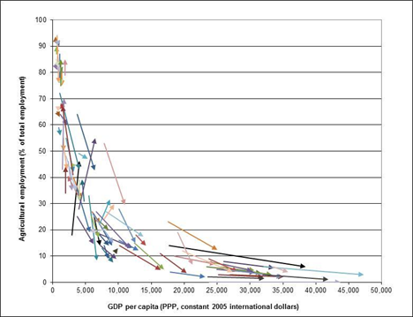
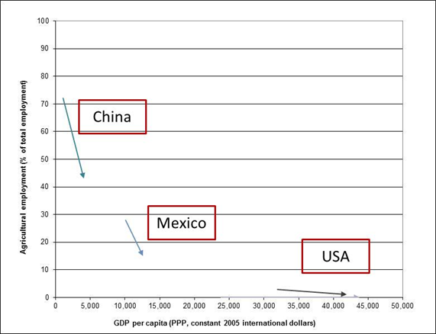
Fleeing Farms Around the World
The % of workforce in agriculture falls as per-capita incomes rise
Workforce in Agriculture
Income
Source: Taylor and Lybbert, RebelText: Essentials of Development Economics, 2012 (forthcoming, UC Press, 2014).

Slide 7
Is Something Happening Out There?
Farmers across California are experiencing the same problem: Seasonal workers who have been coming for decades to help with the harvest, planting and pruning have dropped off in recent years.
SF Chronicle, May 27, 2012
The workforce has been decreasing in the last two to three years, but last year it was drastic.
Kristi Boswell, Farm Bureau
The supply of Mexican labor available to work in the United States has fallen due to a sharp decrease in Mexico’s total fertility rate and employment growth in Mexico.
Passel, et al. (2012)

Slide 8
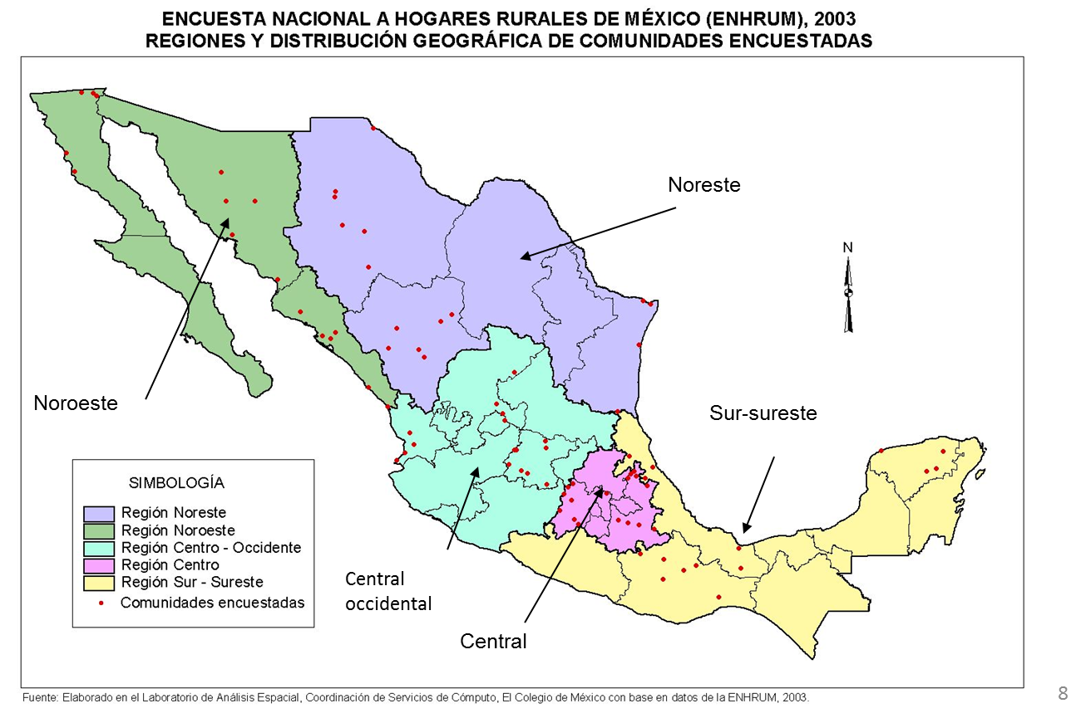
The UCD-COLMEX Mexico National Rural Household Survey (ENHRUM)
Nationally representative sample of rural households
Tracks workers from 1980 through 2010, inside and outside Mexico
More than 125,000 person-years of data

Slide 9
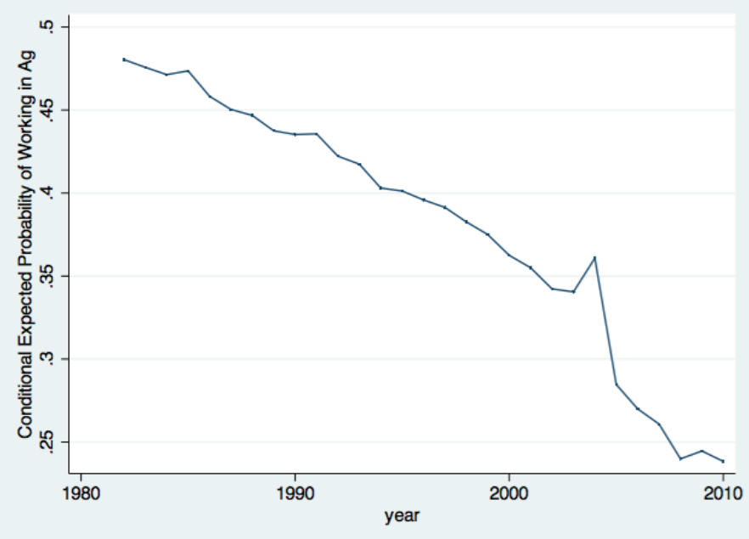
Probability of Rural Mexicans Working in Ag (anywhere, in Mexico or the US)
The farm labor supply from rural Mexico is decreasing by 11,200 people each year
• Mexican and CA farmers have to compete for this dwindling number of farmworkers
Source: Charlton and Taylor (2014)

Slide 10
Downward Trends in all Regions of Mexico

Slide 11
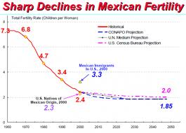
WHY the Negative Trend?
A falling birthrate:
Source: Jeffrey Passel, PEW Research Center
A growing non-farm economy:
Recession

Slide 12
…And Rural Schools!
% of rural Mexico’s working-age population with a secondary school in their village at age 12

Slide 13
How It All Stacks Up
Border Patrol, line watch hours
Building schools
Sum of BP, schools, & non-farm GDP
Non-farm GDP value added
Source: Estimates by Diane Charlton, UCD ARE

Slide 14
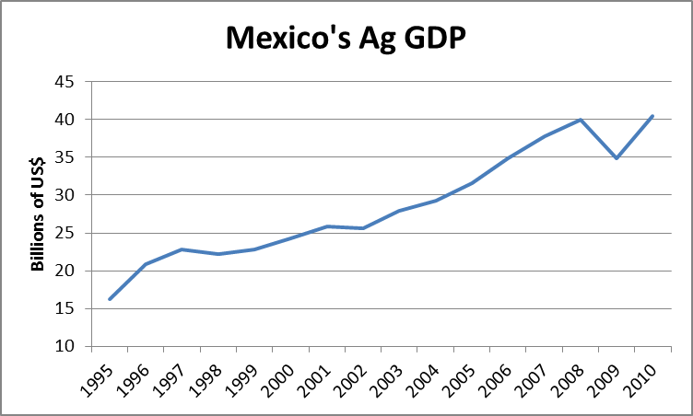
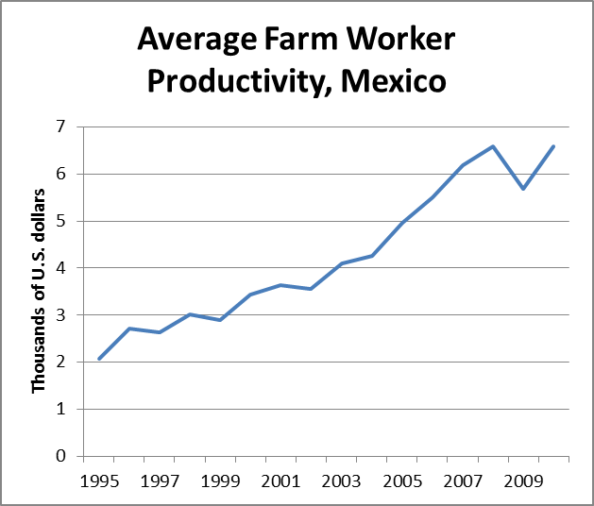
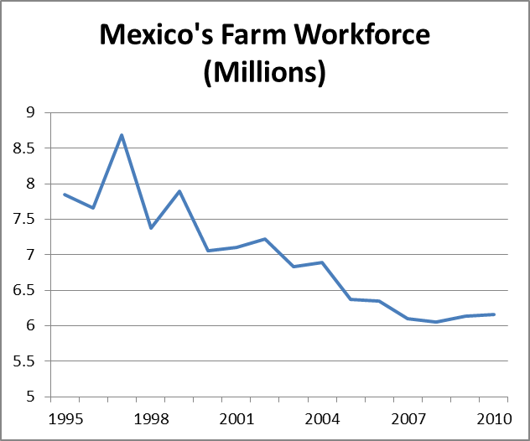
What It Means to Mexico:
Producing More with Less
Rising productivity in Mexico means higher farm wages in CA
Nonfarm wages are now the major source of household income in rural Mexico

Slide 15
What It Means for Immigration Policy
US workers stopped doing hired farm work in the 1900s
  A few US kids dream of being farmers, but not hired farmworkers
  Immigration solved our farm labor problem
      Mexico was at an earlier stage of the farm labor transition
As rural Mexicans shift out of farm work, immigration policy stops being the solution

Slide 16
What It Means to California Farms
Farms will have to produce more with fewer workers:
  Changing crop mixes
  More efficient labor management practices
    There are about 2 farmworkers per year-round equivalent farm job in CA!
  Technological change: mechanization
    New tech solutions to make a smaller (and older!) farm workforce more productive
    UC should be leading the way here…

Slide 17
What It Means for CA Farm Workers and Rural Communities
Low productivity means low wages and high poverty rates for farmworker families
  CA has the richest agriculture in the world and farmworker communities with per-capita incomes lower than Mexico’s
Making farmworkers more productive is the key to raising earnings
A smaller, more skilled & productive farm workforce is good news for CA’s rural communities

Slide 18
Immigration Policy in an Era of Diminishing Ag Labor Supply
Decreasingly Ag Labor Supply from Rural Mexican Households
Falling Fertility
Rural Schools
Nonfarm Growth
Intervening variables
US Farms
Mexico’s Farms
Economic Conditions in U.S. and Mexico
U.S. Immigration Policy
Border Violence
Weakening Networks
Immigration policy plays a role, but it is only an intervening variable against the backdrop of a diminishing farm labor supply in Mexico

Slide 19
Final Policy Lessons
Don’t assume immigration will solve the farm labor problem
  The labor has to be there
Adjust to a future with fewer workers
  Get over the tomato harvester
  Robots assisting farmworkers in the fields?
Educate the future farm workforce
  …or import engineers from Mexico?
Good news for ag workers, communities
  Less labor, higher productivity → higher wages

Slide 20
References
J. E. Taylor, D.E. Charlton, and A. Yunez-Naude (2012). “The End of Farm Labor Abundance.” Applied Economic Perspectives and Policy, 34(4):587-598, http://aepp.oxfordjournals.org/content/34/4/587.full.pdf+html
D.E. Charlton and J.E. Taylor (2013). ARE Update. “Mexicans Are Leaving Farm Work: What Does It Mean for U.S. Agriculture and Immigration Policy?” Agricultural and Resource Economics Update 16(4): 1-4, 2013. http://giannini.ucop.edu/media/are-update/files/articles/V16N4_1.pdf
D.E. Charlton (in progress). A Declining Farm Workforce: Analysis of Panel Data from Rural Mexico and Implications for U.S. Farms. Chapter in Ph.D Dissertation, UCD Department of Agricultural & Resource Economics.
J.E. Taylor and D.E. Charlton (2014). Adjusting to a Post-NAFTA Mexico: What It Means for California. Prepared for the Legislative Hearing on “NAFTA: Challenges and Opportunities after 20 Years,” Hearing of the Senate Select Committee on California-Mexico Cooperation, State Capitol Building, May 5, 2014.

